Slide 1




Land Temperature and Hydrological Conditions in 2017
Plus: Introduction of High Elevation Weather Station Network

Slide 2
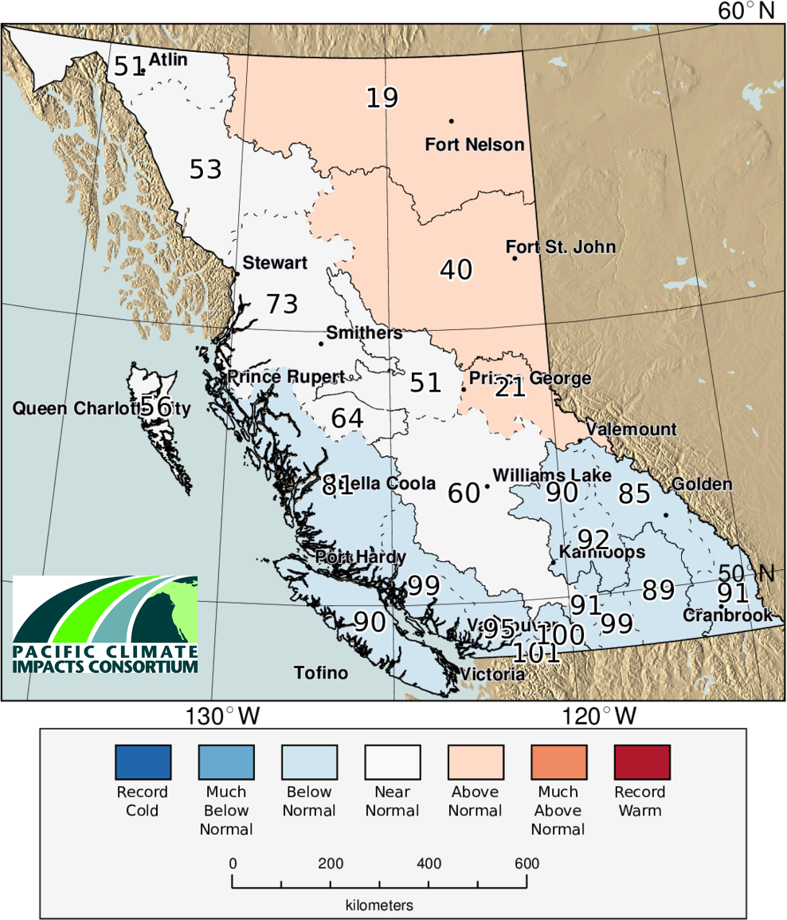
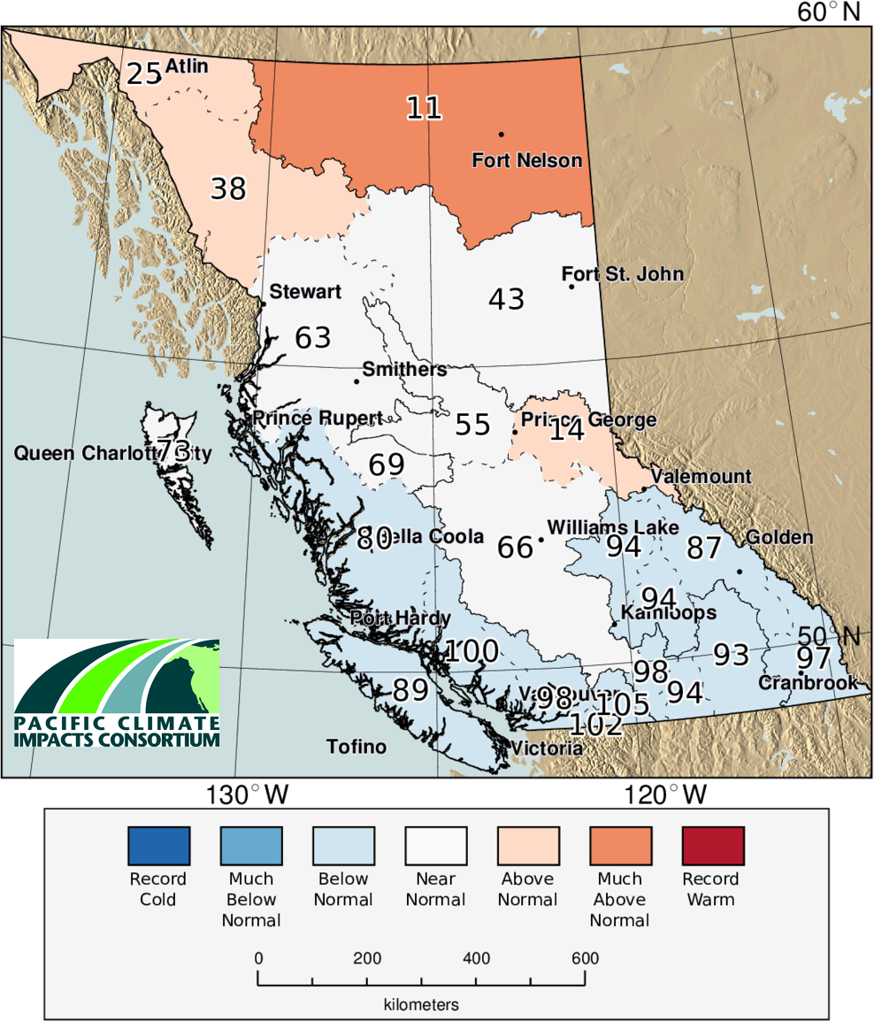
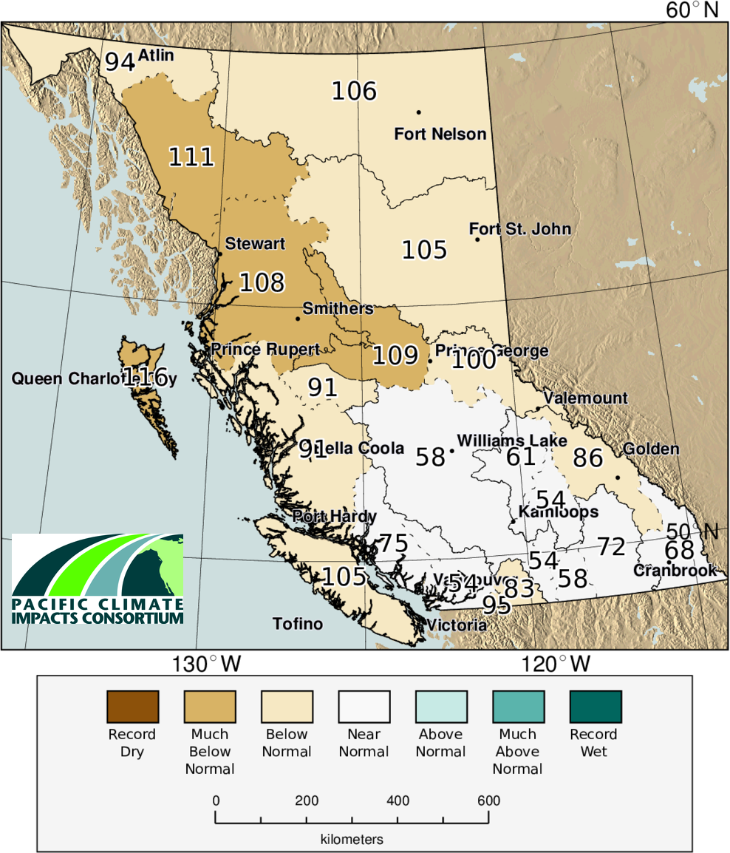
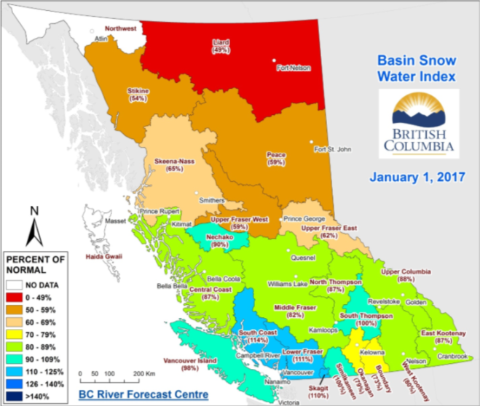
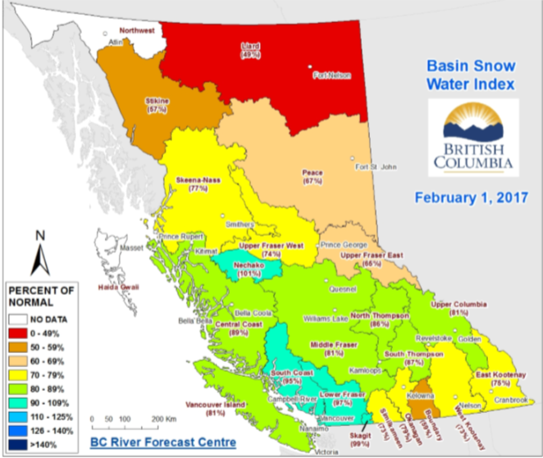
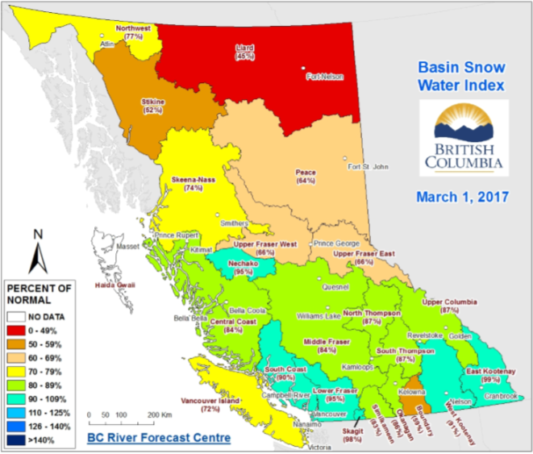
Winter 16/17

Slide 3
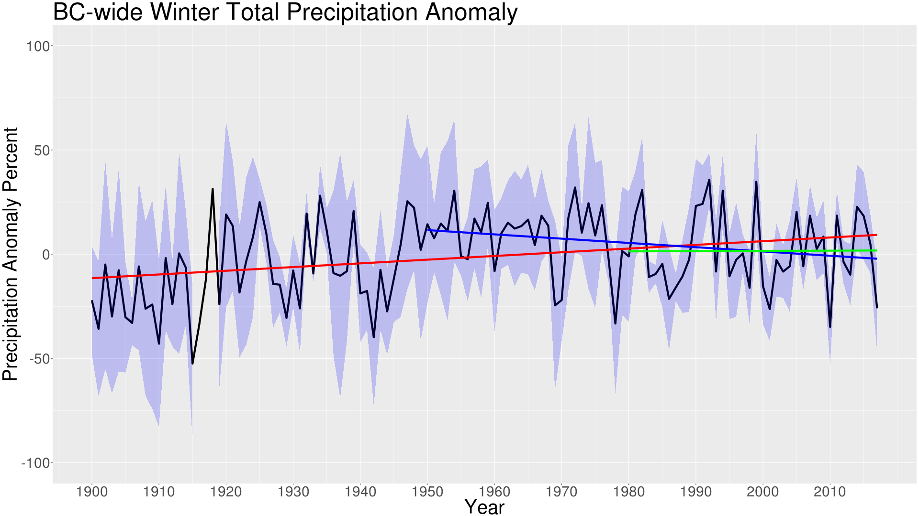
Winter Trends
Winter | 1900-2017 | 1950-2017 | 1980-2017
Tmax (°C yr⁻¹) | 0.020 | 0.042 | 0.028
Tmin (°C yr-1) | 0.032 | 0.059 | 0.048
Tmean (°C yr-1) | 0.025 | 0.052 | 0.040
Precip. (% yr⁻¹) | 0.18 | -0.20 | 0.01

Slide 4
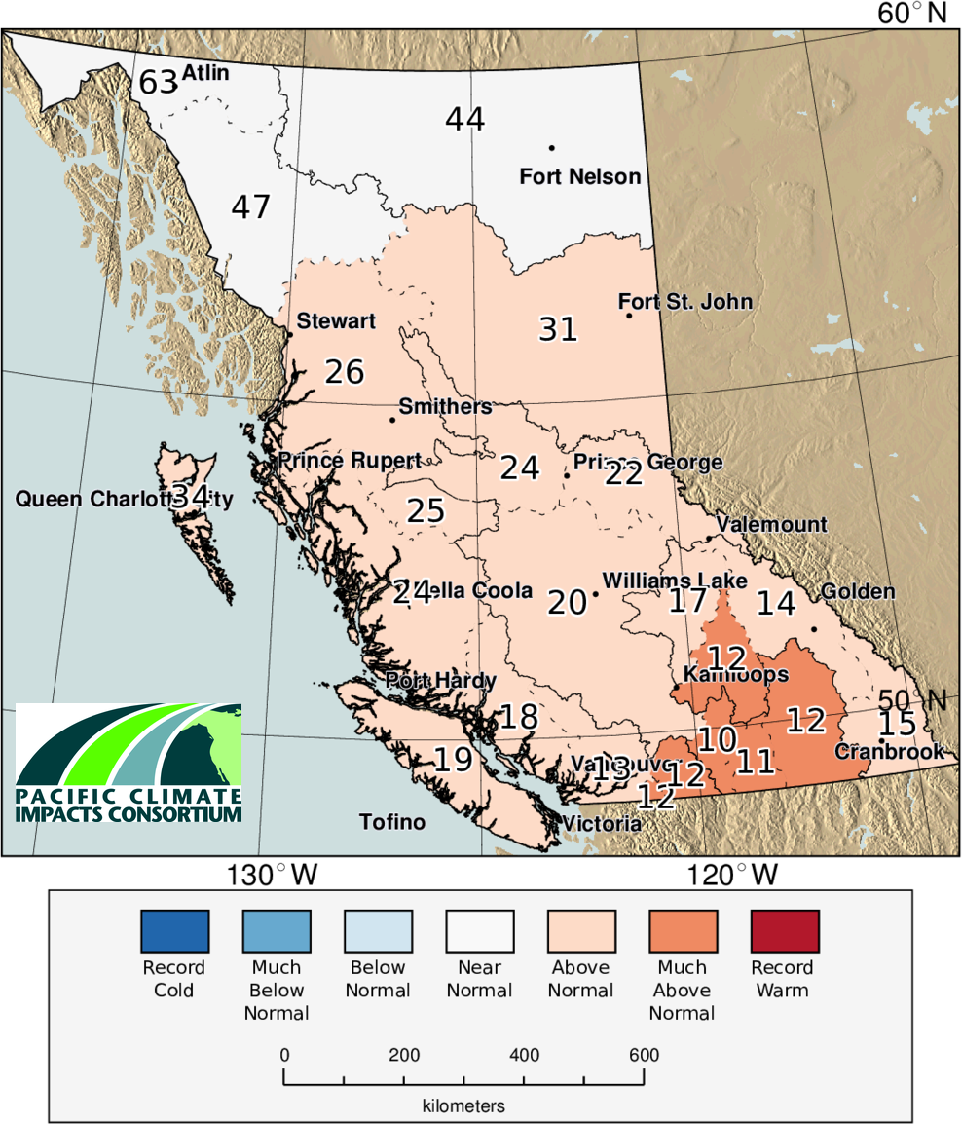
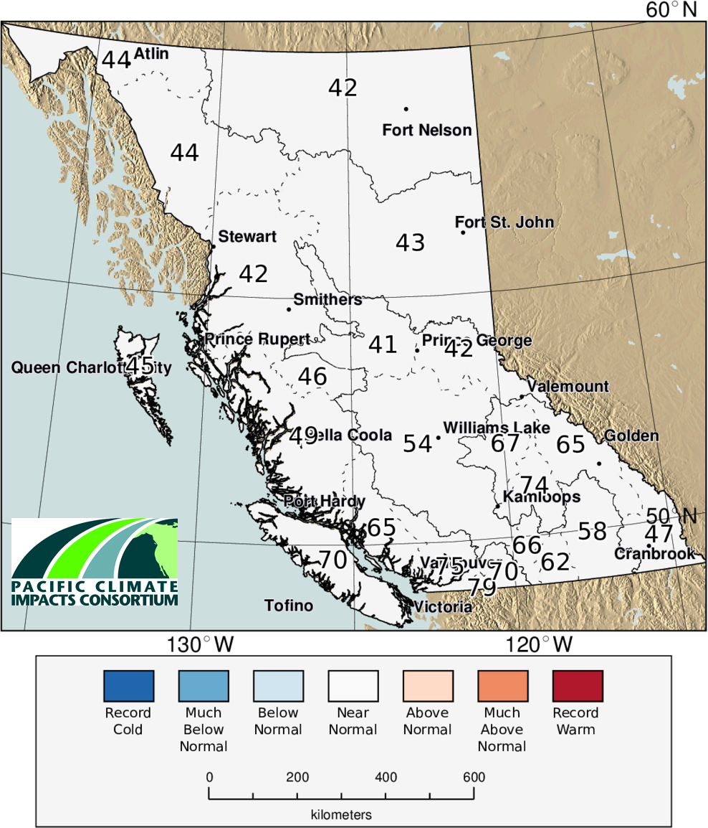
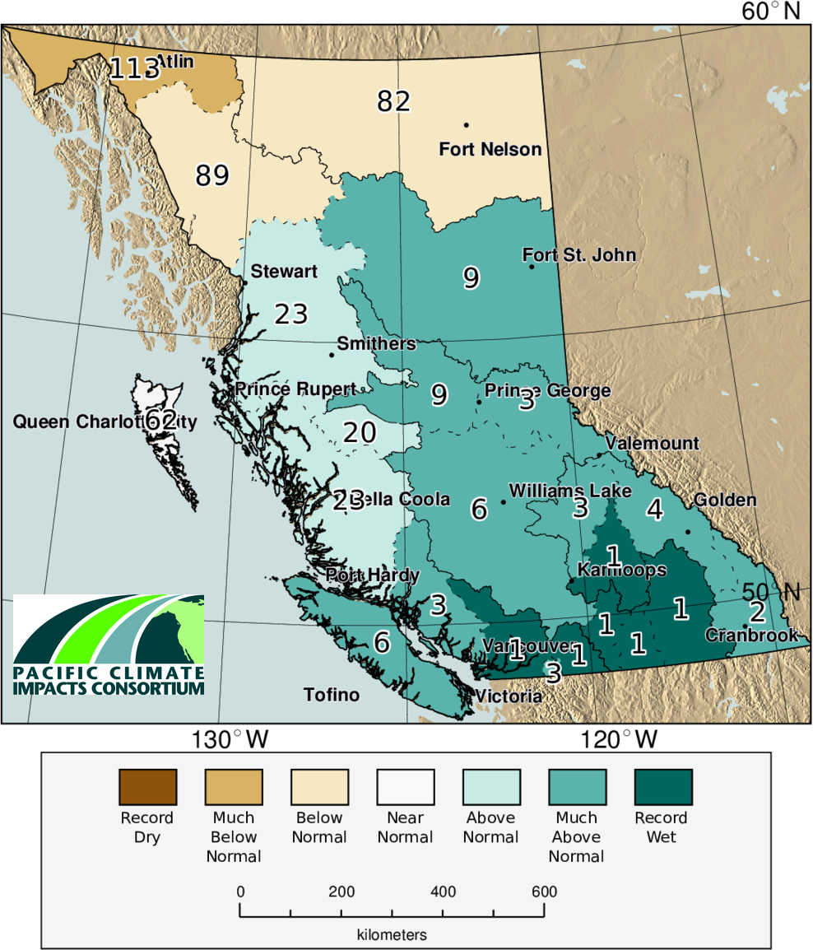
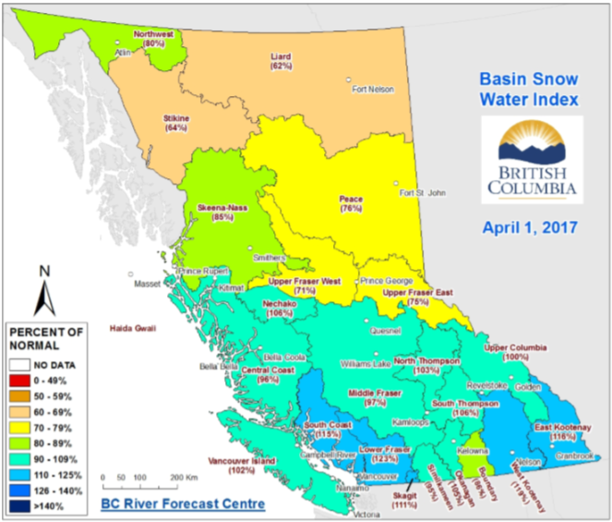
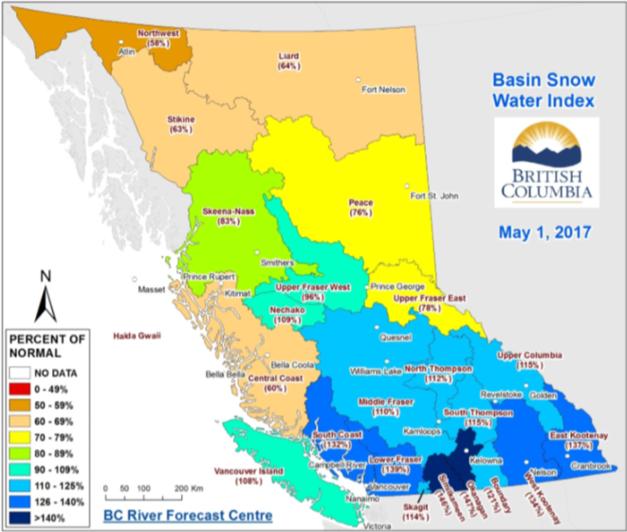
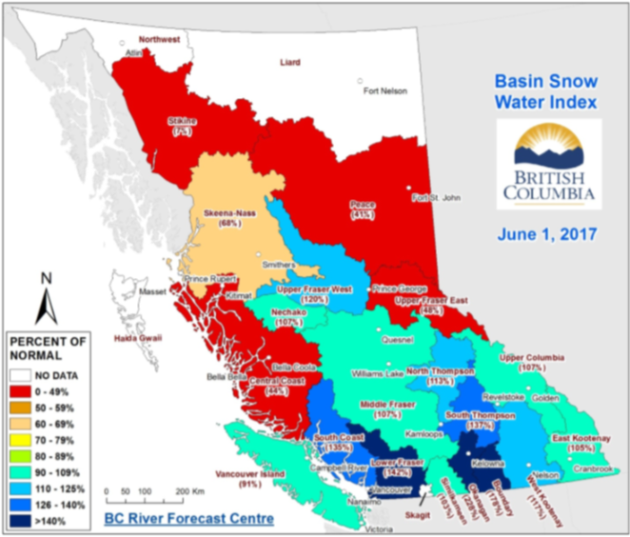
Spring

Slide 5
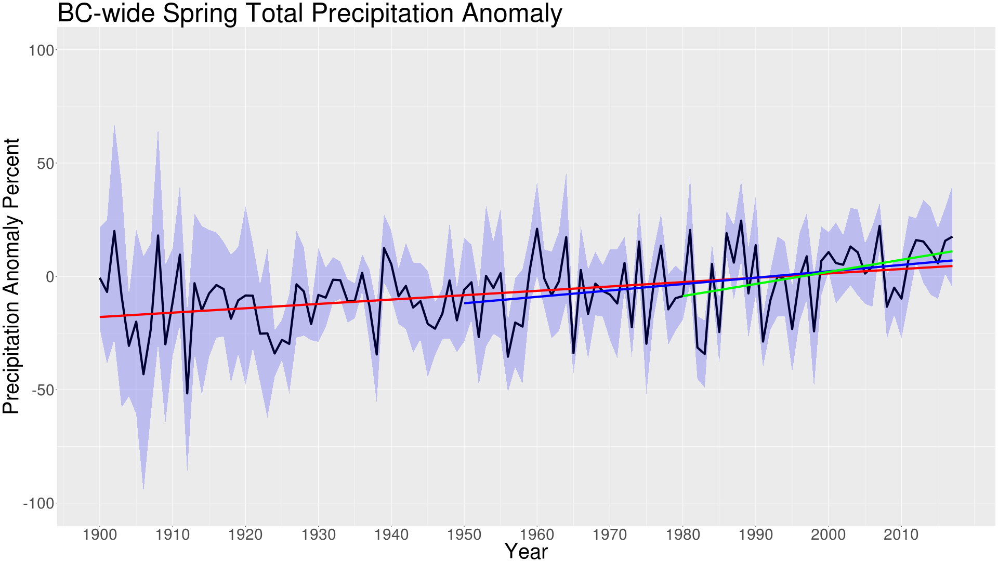
Spring
Spring | 1900-2017 | 1950-2017 | 1980-2017
Tmax (°C yr⁻¹) | 0.009 | 0.023 | -0.007
Tmin (°C yr-1) | 0.021 | 0.031 | 0.000
Tmean (°C yr-1) | 0.015 | 0.028 | -0.003
Precip. (% yr⁻¹) | 0.19 | 0.29 | 0.57

Slide 6
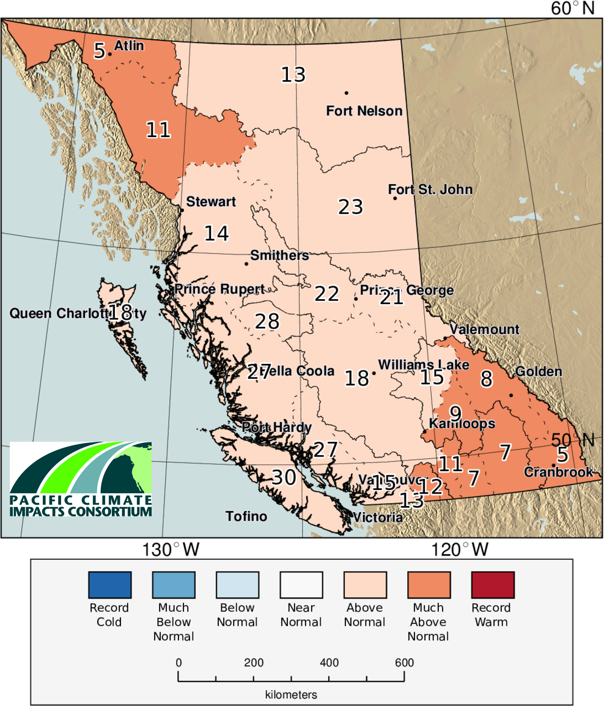
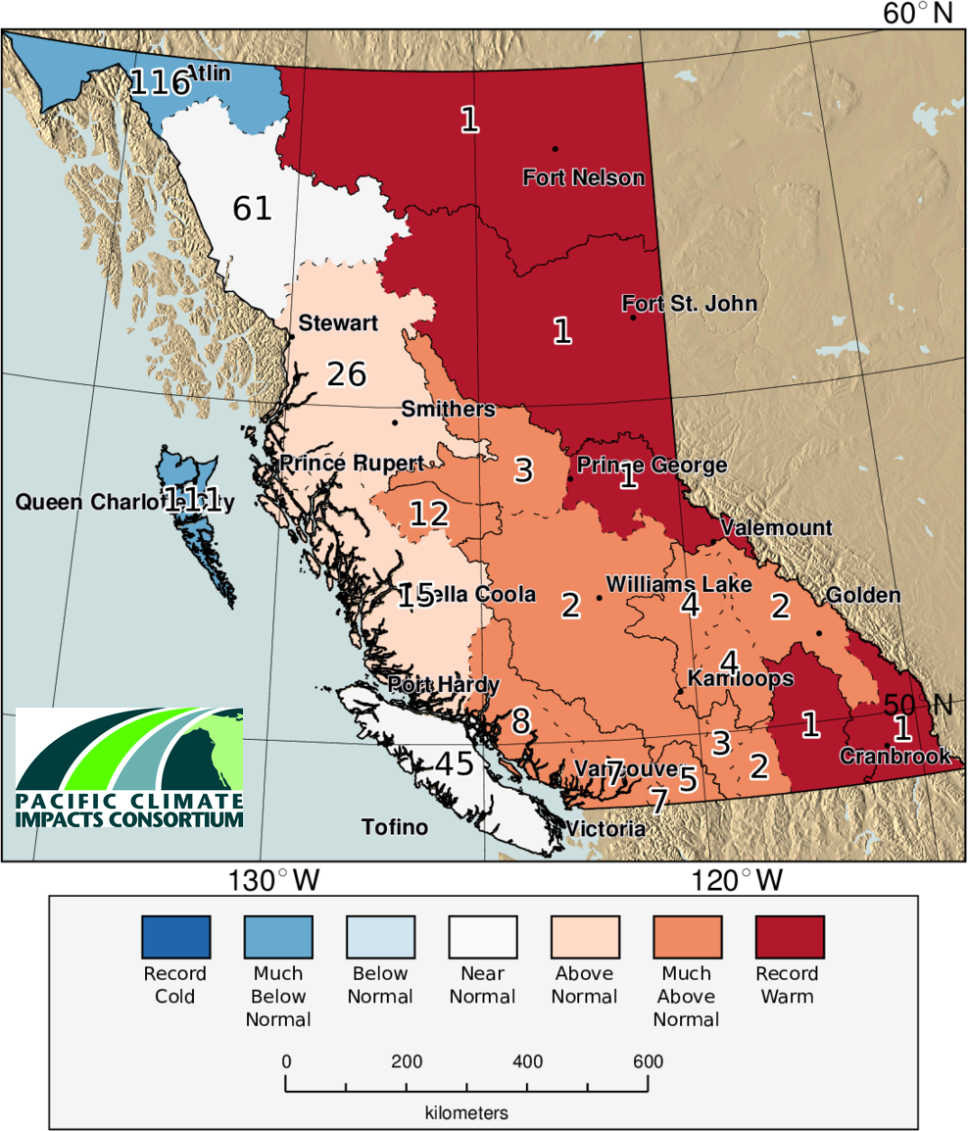
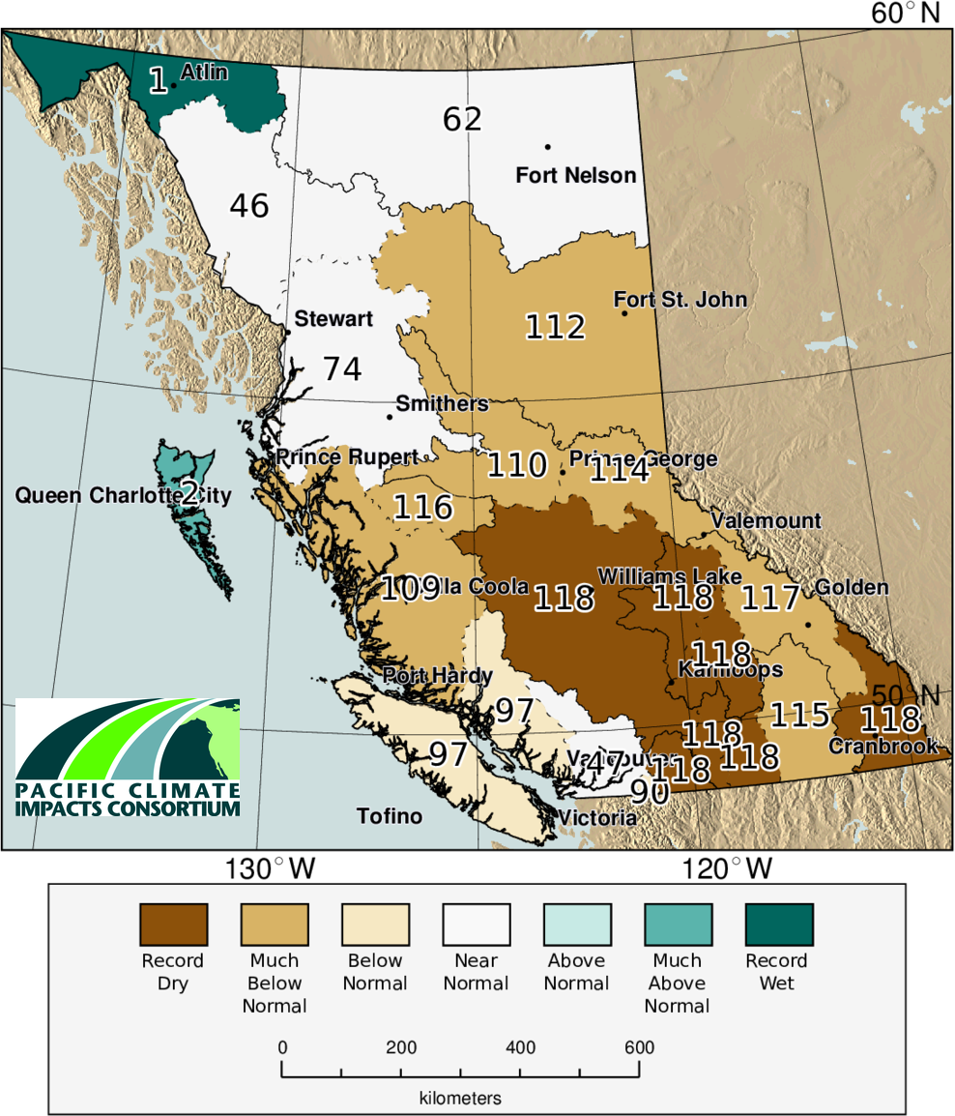
Summer

Slide 7
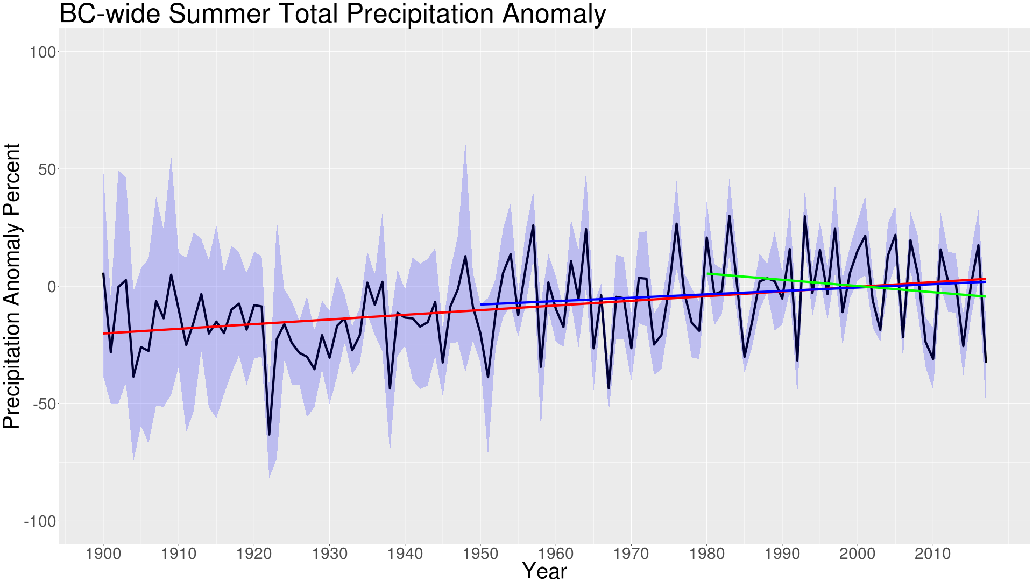
Summer
Summer | 1900-2017 | 1950-2017 | 1980-2017
Tmax (°C yr⁻¹) | 0.004 | 0.015 | 0.035
Tmin (°C yr-1) | 0.025 | 0.022 | 0.029
Tmean (°C yr-1) | 0.014 | 0.019 | 0.031
Precip. (% yr⁻¹) | 0.20 | 0.14 | -0.26

Slide 8
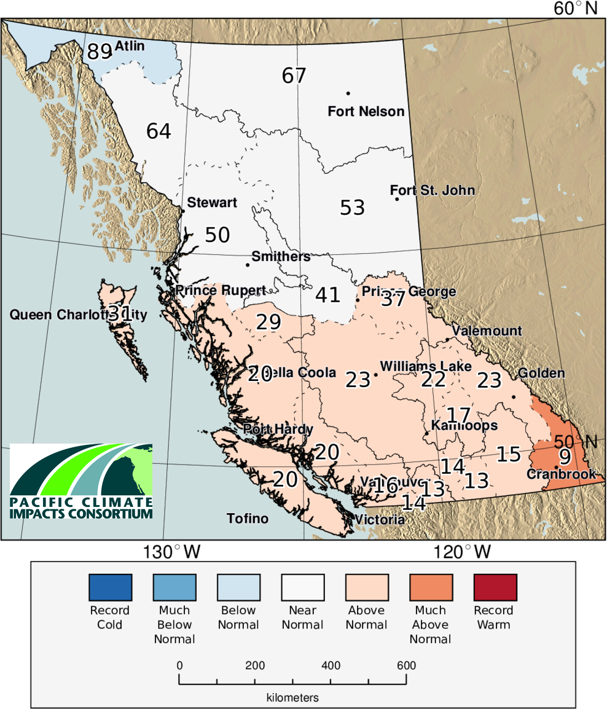
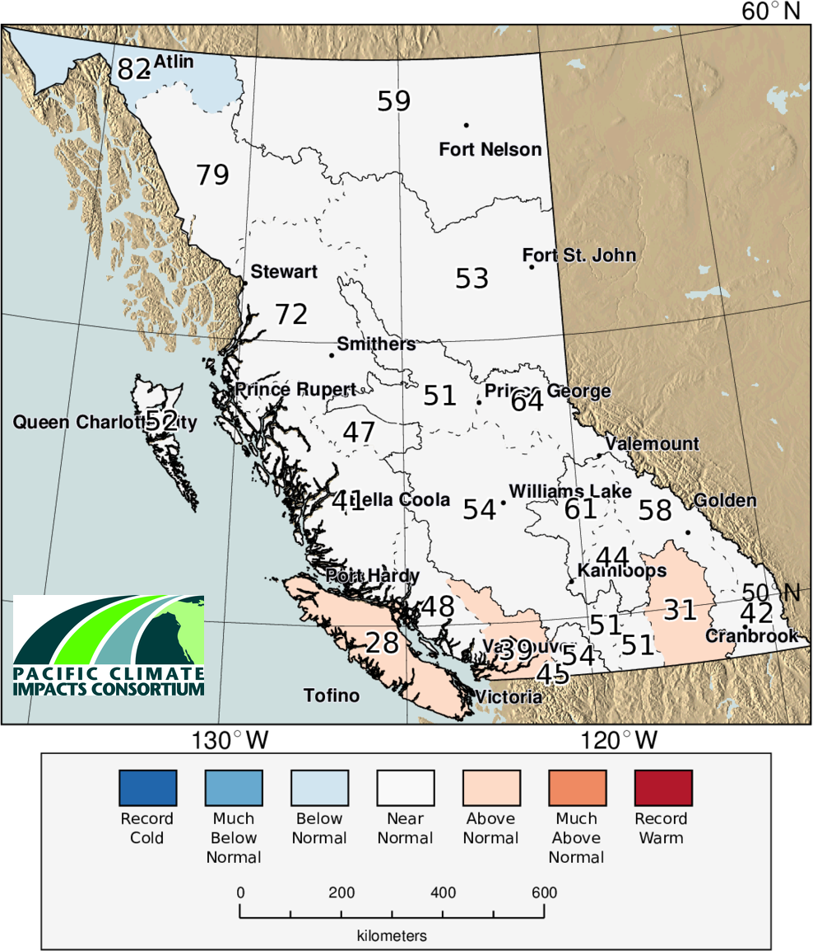
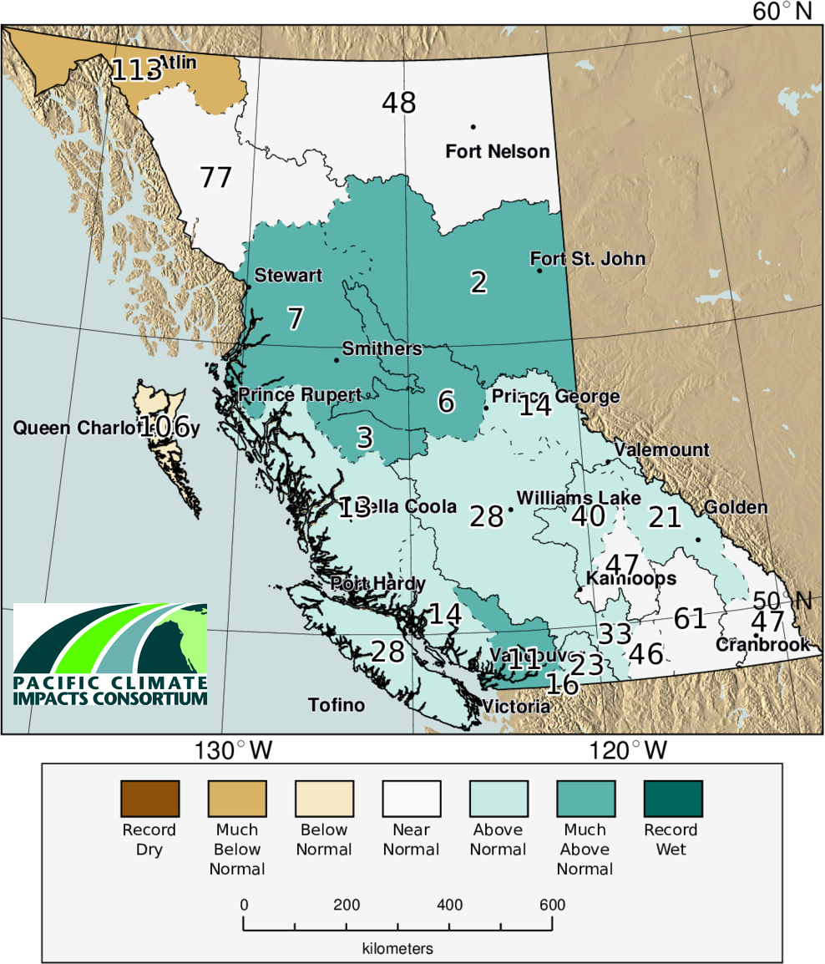
Fall

Slide 9
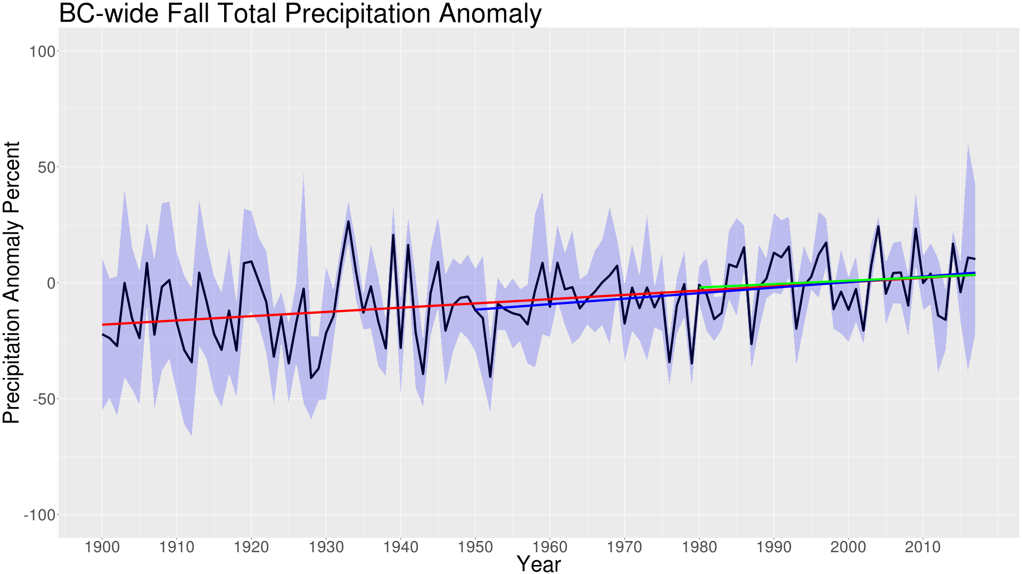
Fall
Fall | 1900-2017 | 1950-2017 | 1980-2017
Tmax (°C yr⁻¹) | 0.000 | 0.008 | 0.008
Tmin (°C yr-1) | 0.015 | 0.016 | 0.019
Tmean (°C yr-1) | 0.007 | 0.013 | 0.014
Precip. (% yr⁻¹) | 0.18 | 0.24 | 0.15

Slide 10
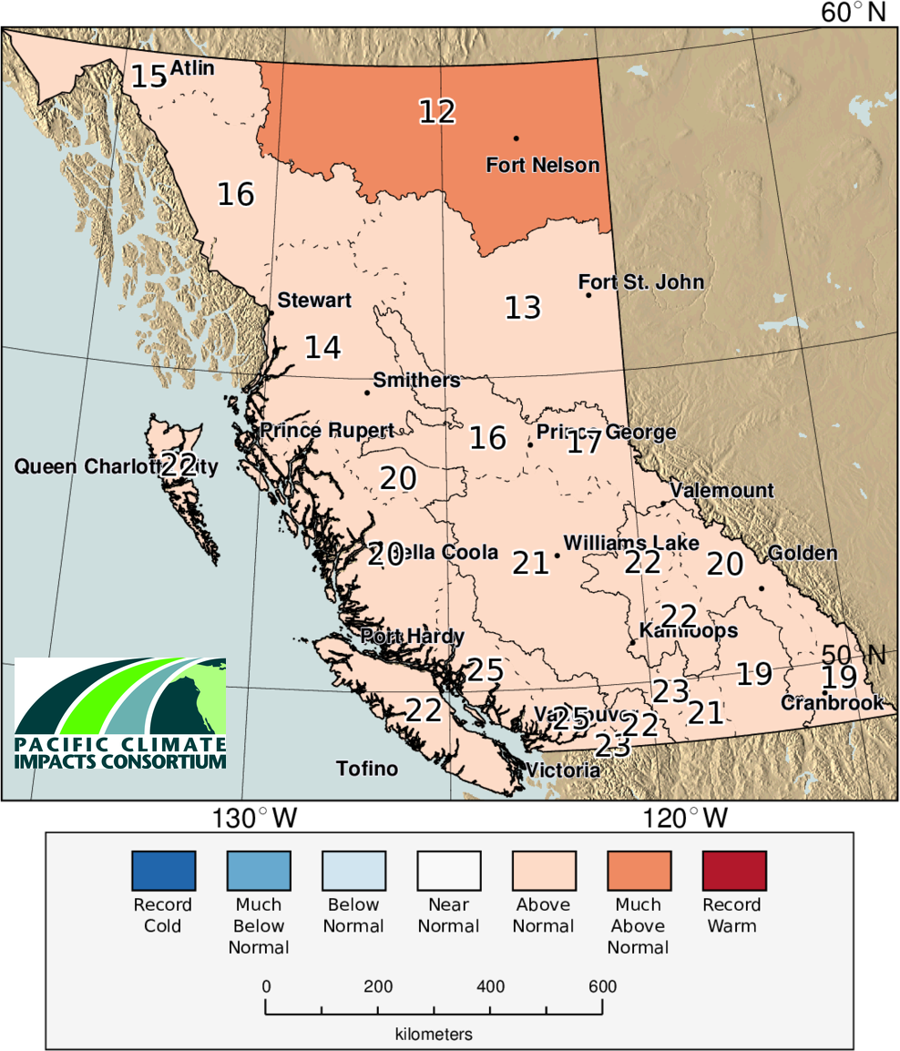
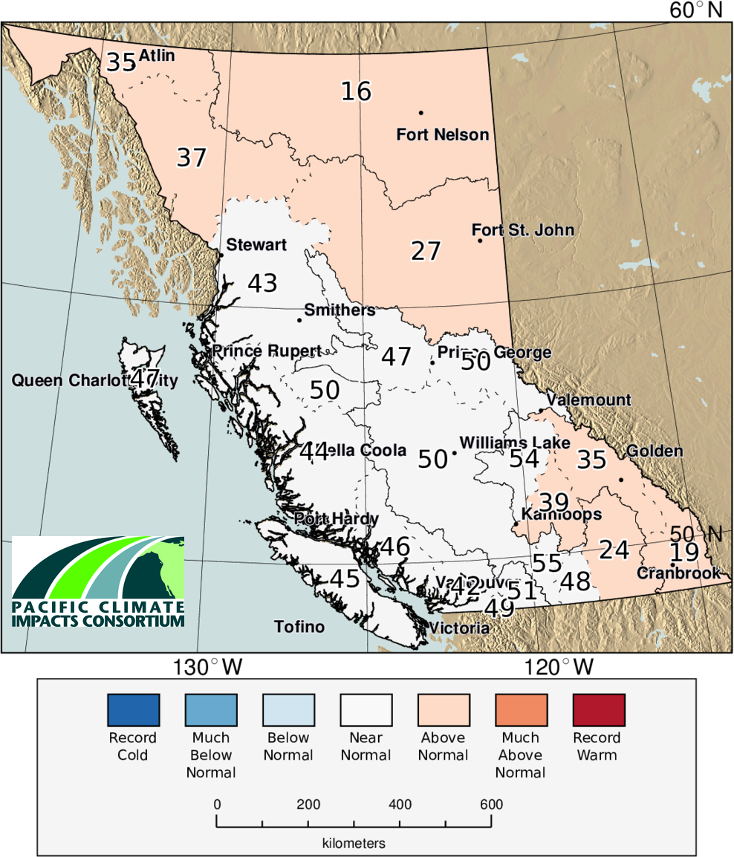
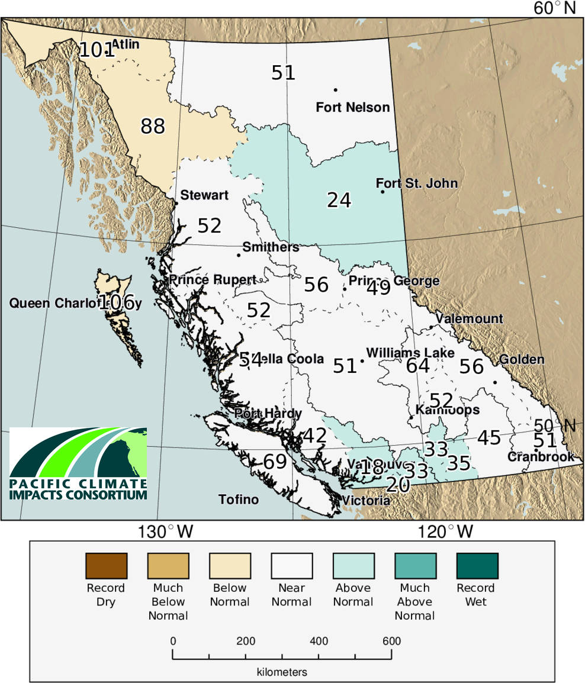
Annual

Slide 11
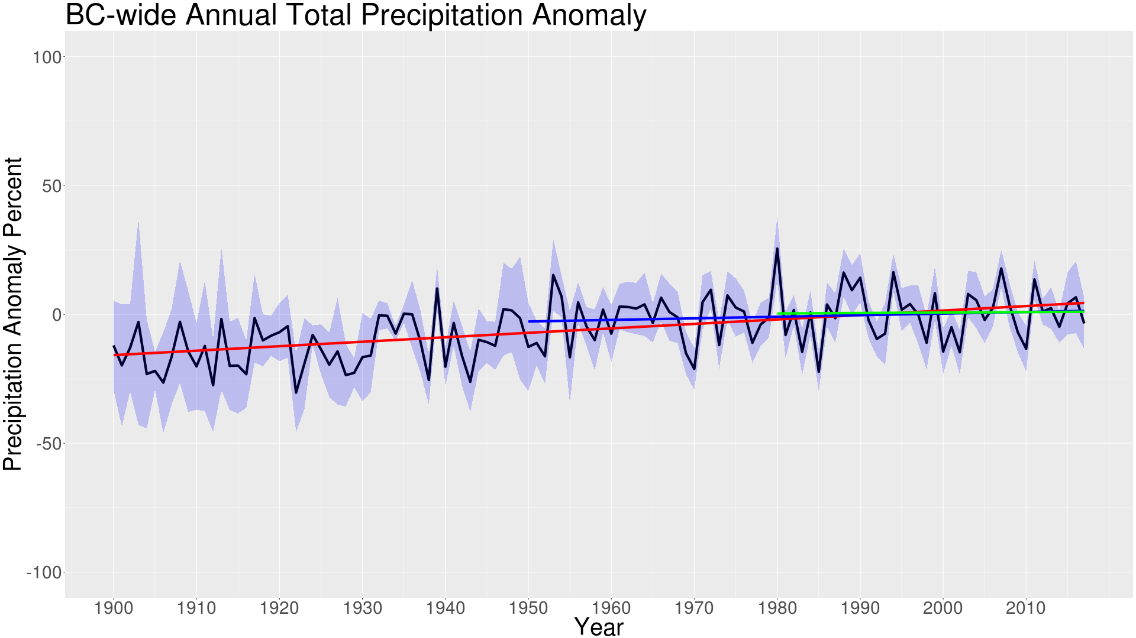
Annual
Annual | 1900-2017 | 1950-2017 | 1980-2017
Tmax (°C yr⁻¹) | 0.008 | 0.022 | 0.019
Tmin (°C yr-1) | 0.023 | 0.031 | 0.025
Tmean (°C yr-1) | 0.015 | 0.027 | 0.022
Precip. (% yr⁻¹) | 0.17 | 0.06 | 0.02

Slide 12
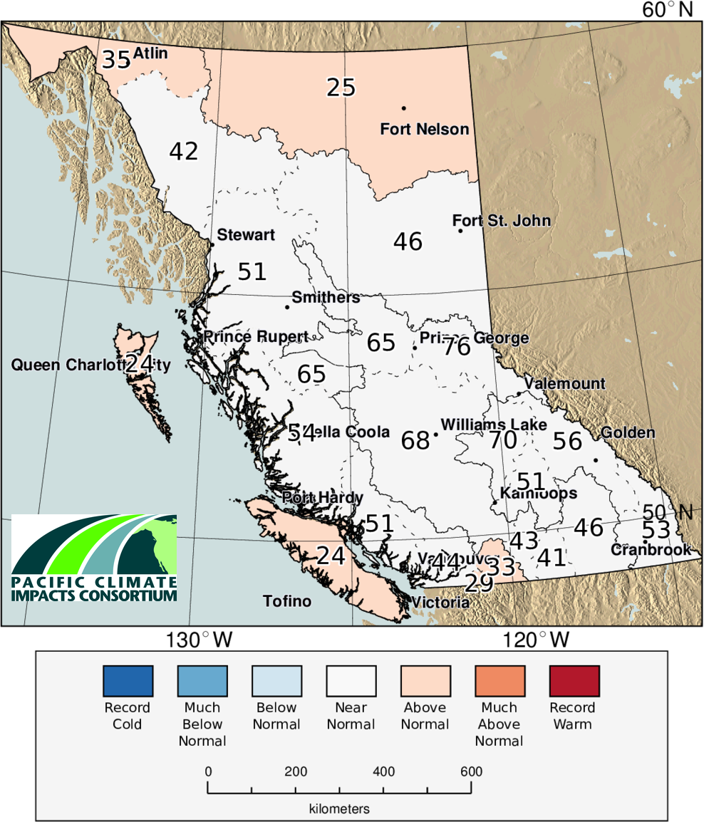
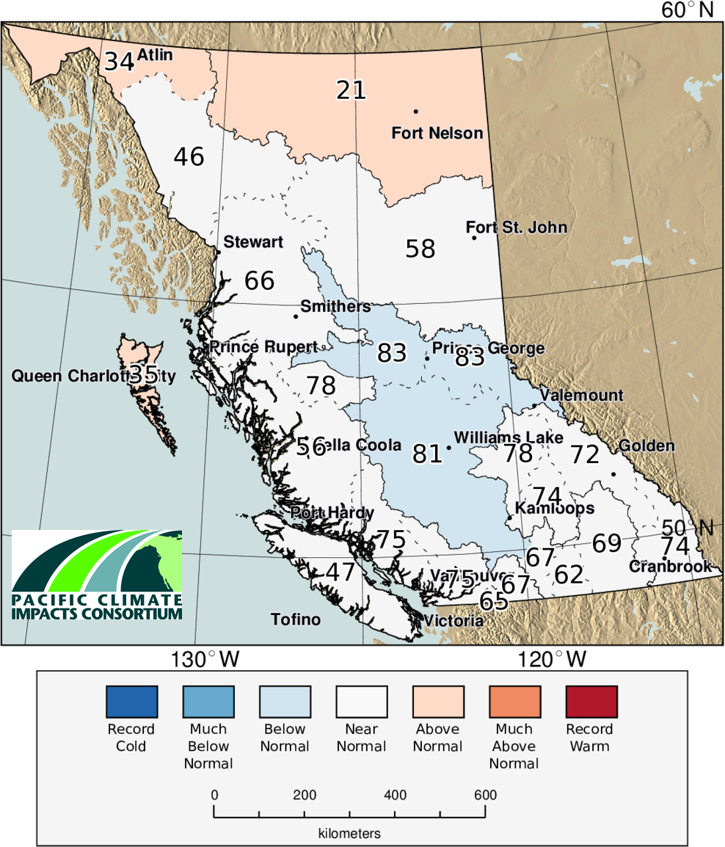
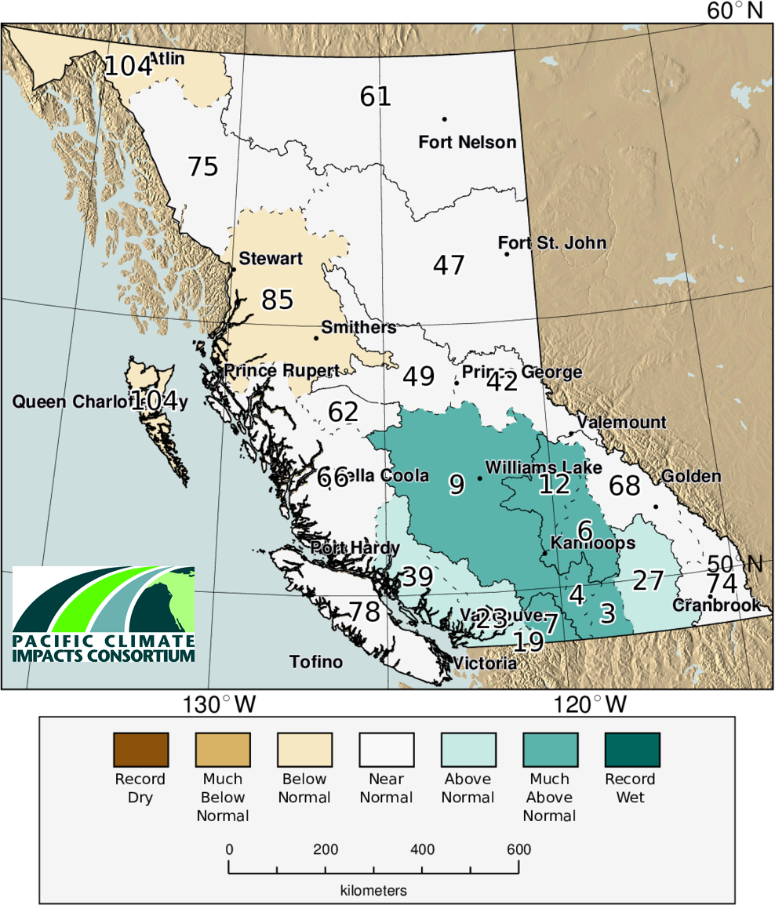
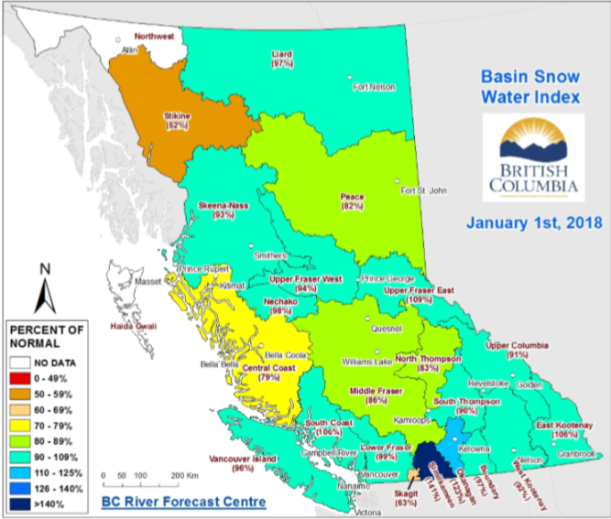
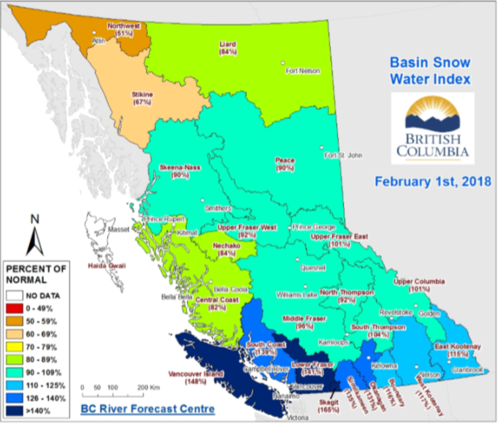
Winter 17/18

Slide 13
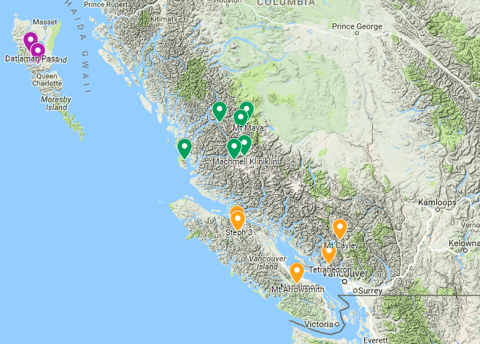










High Elevation Weather Station Network
Data are available in real time
Currently developing real time and historical QAQC data program
Expanding to Comox Watershed and Homathko 2018-2019
  Yellow stars
Regional Districts (water purveyors) are major partners on South Coast and Vancouver Island
Relies on partnerships to be successful and resilient to budget shortfalls by any one agency

Slide 14
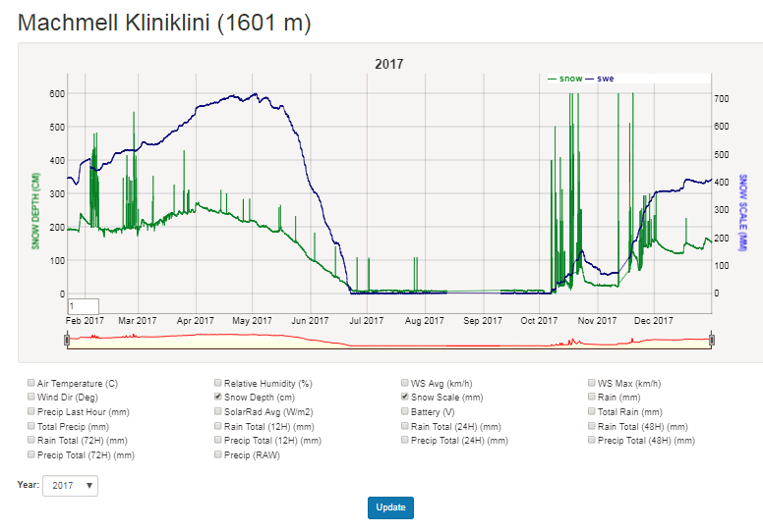
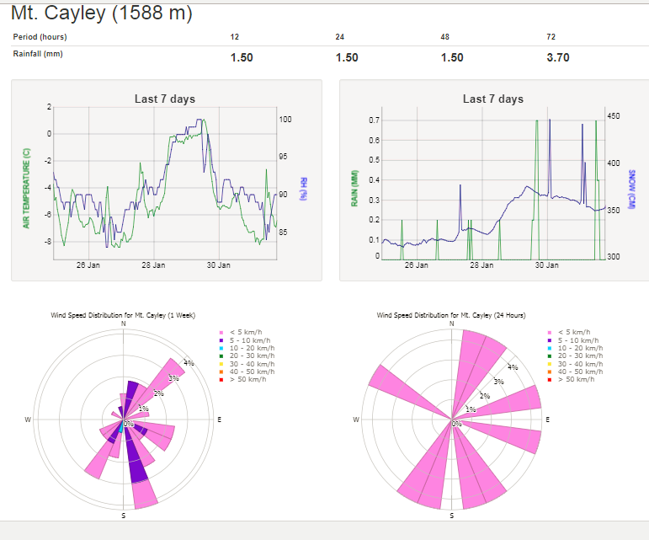

High Elevation Weather Station Network
http://viu-hydromet-wx.ca/graph/
Contact: Bill.Floyd@viu.ca

