Slide 1
Objective Analysis of Observational Network Sufficiency in BC’s Complex Topography
Faron S. Anslow
Stephanie Tam
Jason Lussier

Slide 2
Purpose
The agricultural community in BC as well as BC ministries as a whole are interested in optimizing coverage of their observational networks for monitoring climate change.
There are numerous approaches for this, from the analytical approach taken here, to more subjective incorporation of socioeconomic activities or occurrence of high impact events.
The approach I’m presenting uses the information that the historical station data contain about inter-station relationships.
Let the station data that we have tell us at what spatial scales monitoring is needed both in general for BC and for local regions.

Slide 3
BC’s Operational Observational Network

Slide 4
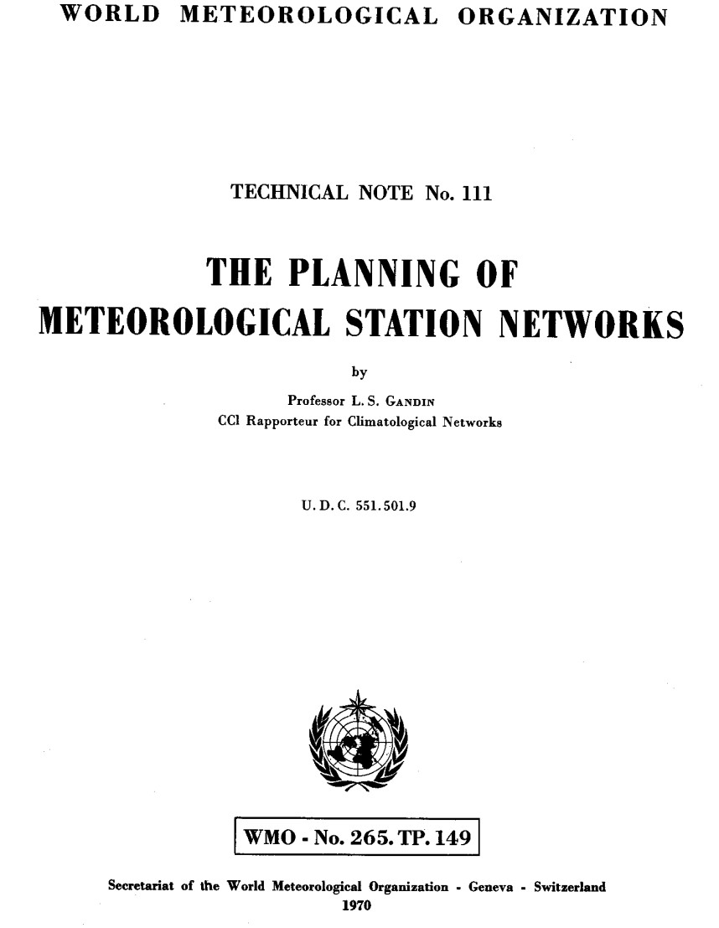
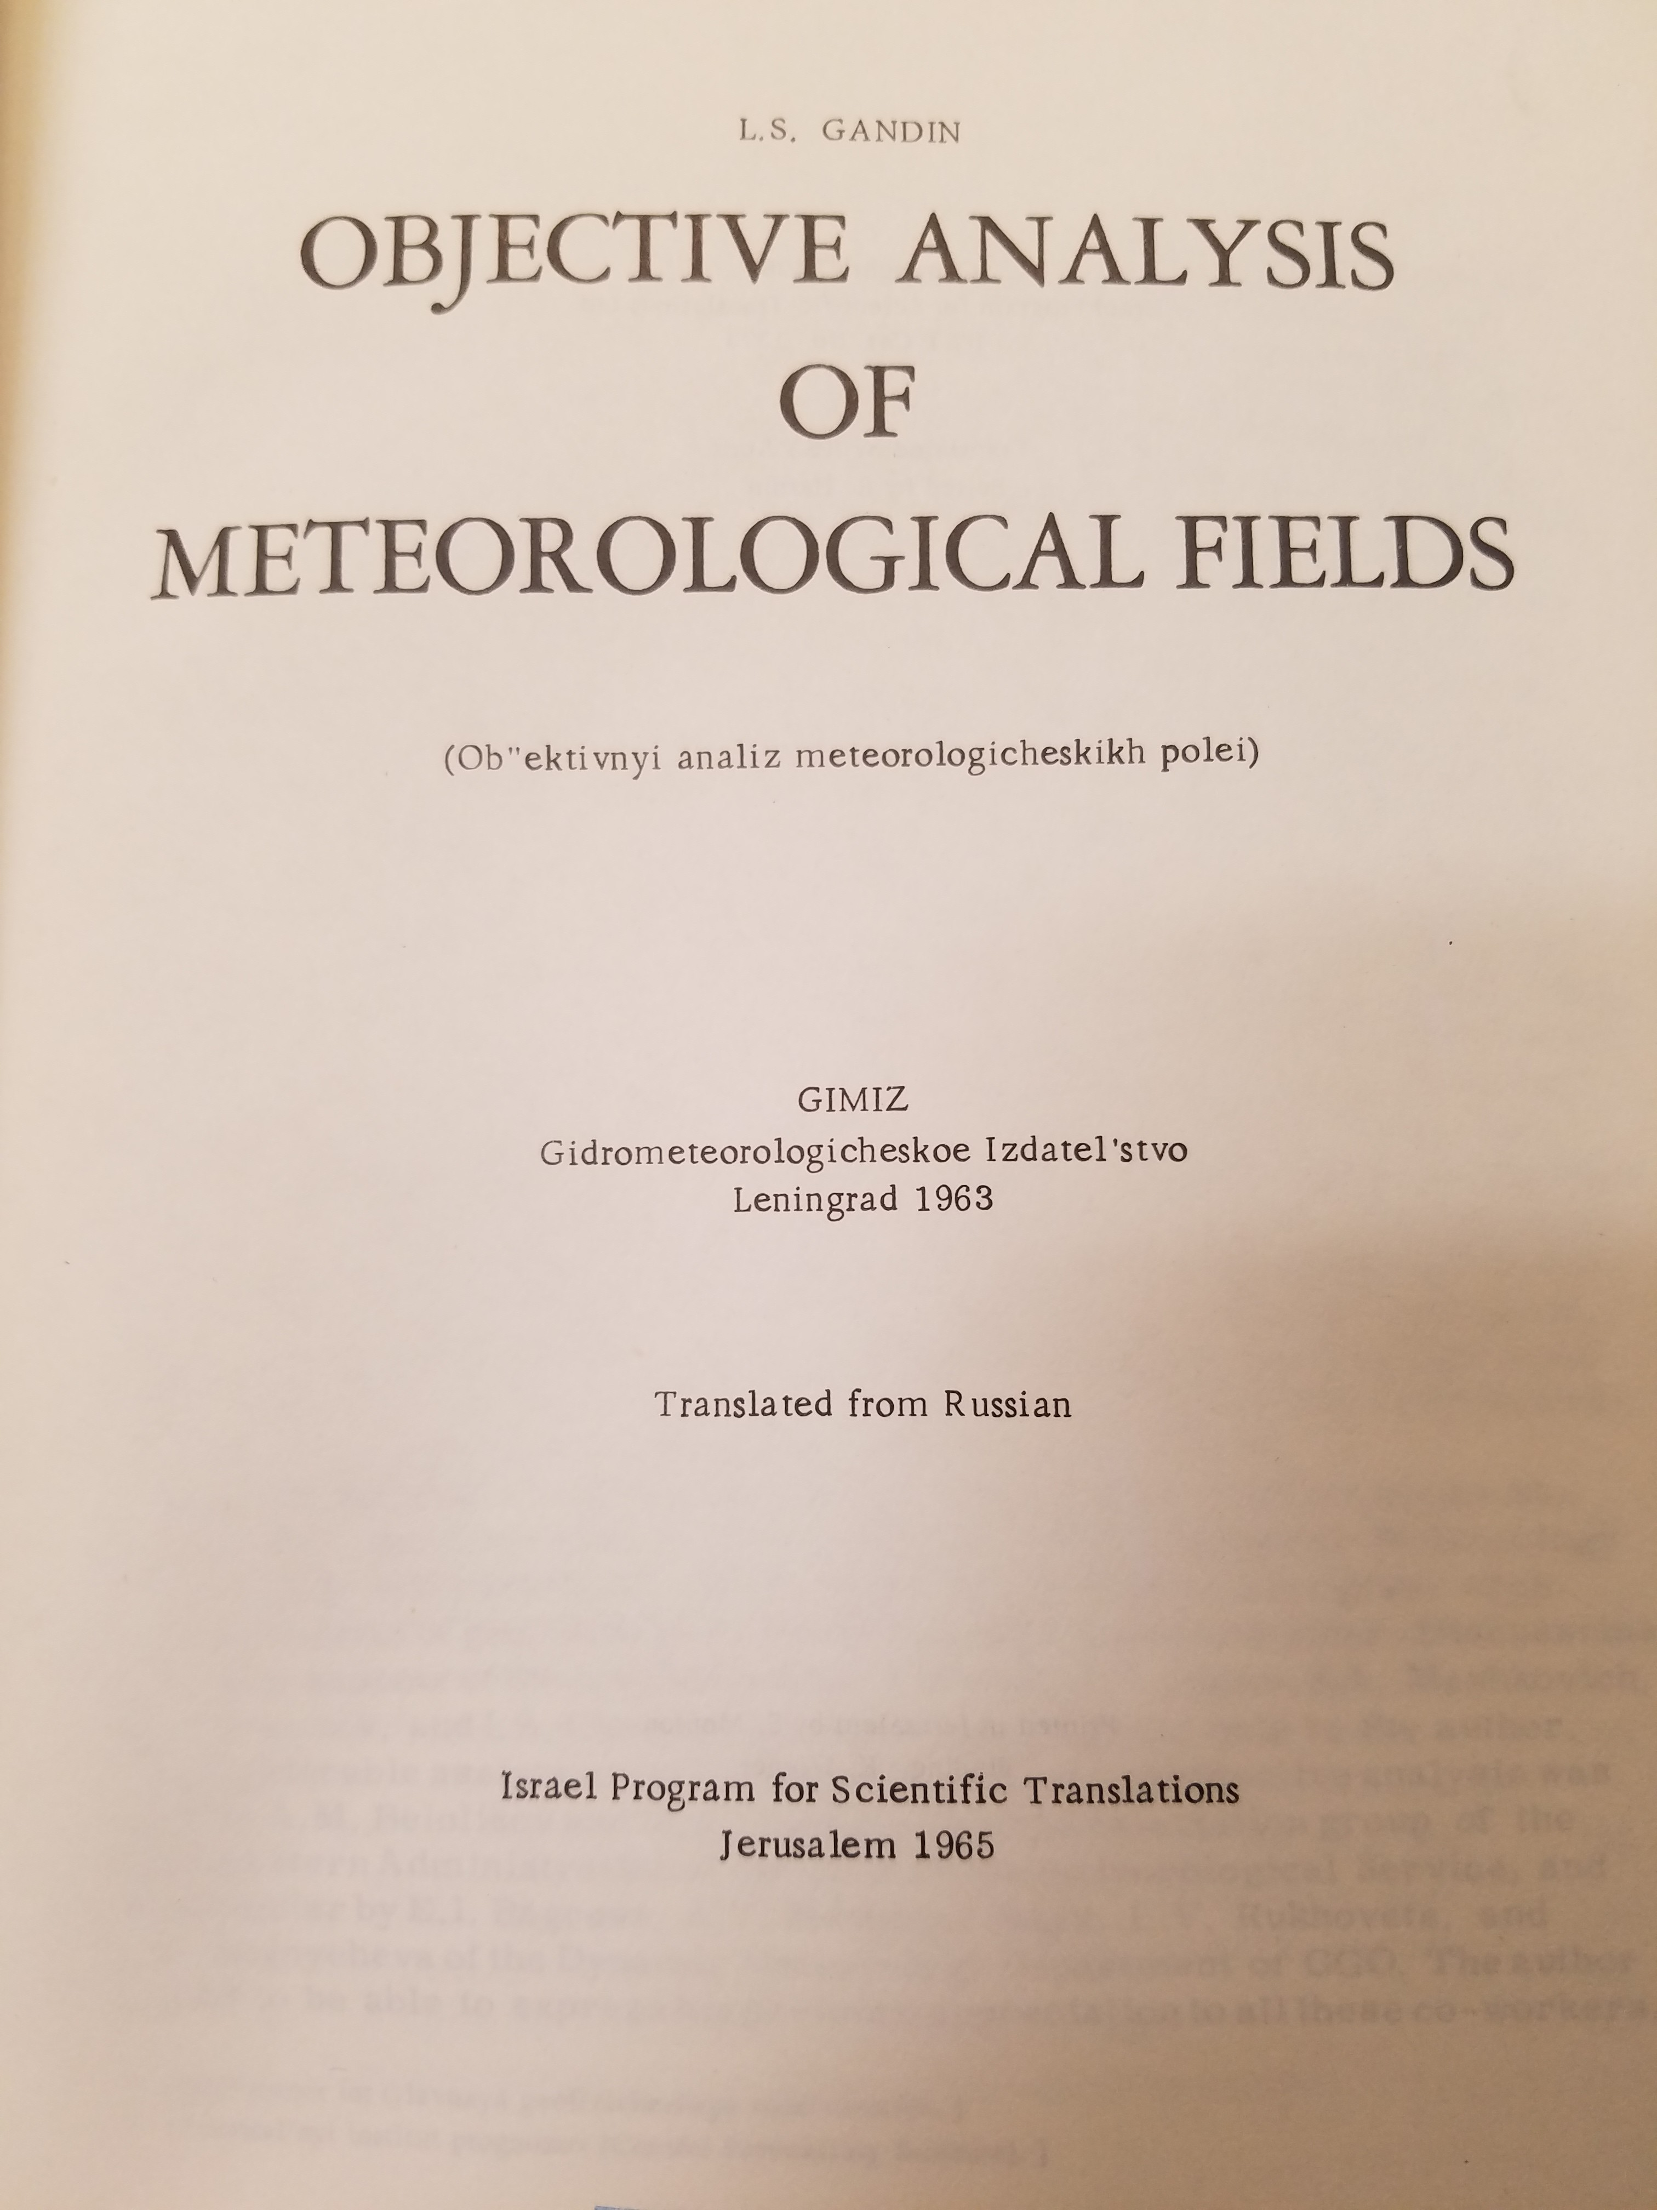
Introduction/Approach
This is not a new problem! With the introduction of computer weather modelling and computerized analysis of weather data in the 1960s and 1970s there was a need for more data, a way to decide where stations should be deployed and methods to incorporate observations into models.

Slide 5
Introduction/Approach
This problem incorporates both interpolation of data and assessment of network coverage.
This makes sense: understanding the error in interpolation to places without data as a function of the number of stations that contribute to an interpolated field implies that we can get a handle on how close stations need to be to reach particular accuracy/uncertainty targets.
This line of statistics was started by meteorologists in the 1960s with two dimensional spatial data.
Evolutions of the approach are used today in data assimilation – the process of incorporating observations into models in four dimensions (x,y,z,t).

Slide 6
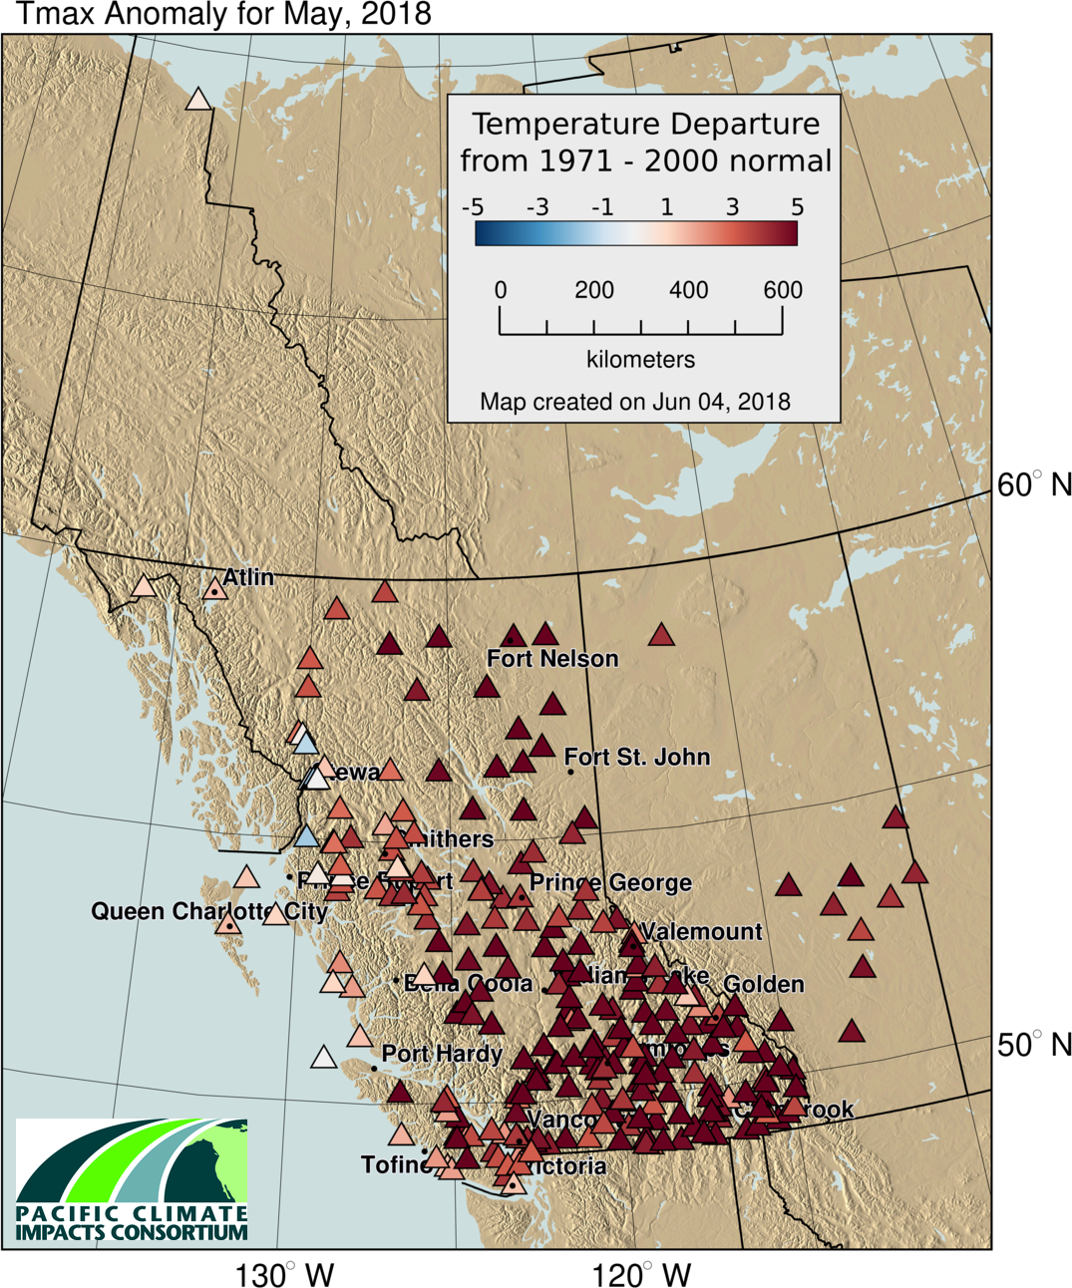
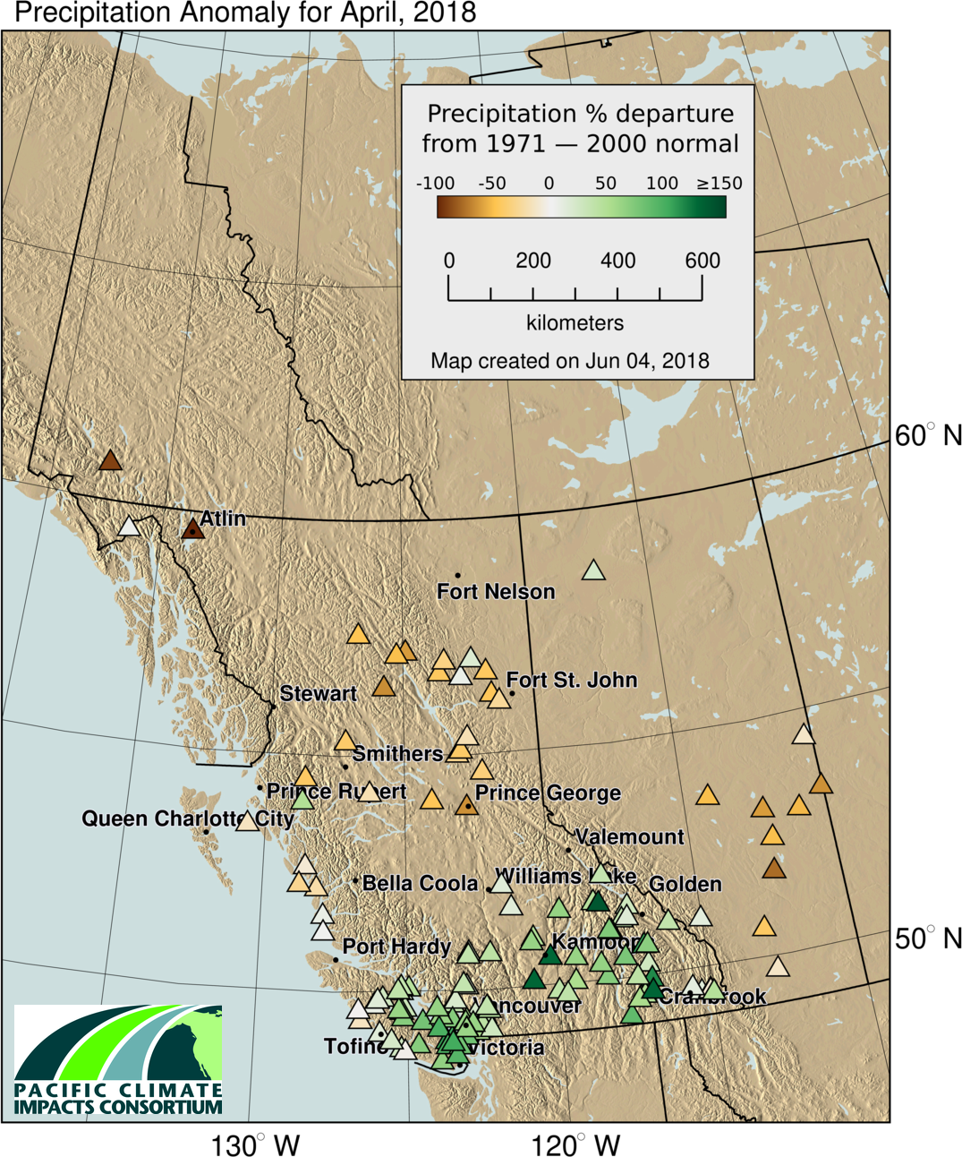

Slide 7
Introduction/Approach
Two components:
The Structure Function:
Describes how the magnitude of the difference between station observations increases with increasing distance.
$$b_{f}\left(\vec{r_{1}},\vec{r_{2}}\right)=\overline{{\left[f′\left(\vec{r_{1}}\right)−f′\left(\vec{r_{2}}\right)\right]}^{2}}$$
The Autocorrelation Function:
Describes how the correlation between observational timeseries decreases (or varies) with increasing distance.
$μ_{f}\left(\vec{r_{1}},\vec{r_{2}}\right)=\frac{\overline{f′\left(\vec{r_{1}}\right)f′\left(\vec{r_{2}}\right)}}{σ\left(\vec{r_{1}}\right)σ\left(\vec{r_{2}}\right)}$
This analysis assumes isotropic and homogeneous spatial relationships, which we will pretend we have even though we don’t.

Slide 8
Idealized Structure/Correlation Functions
Structure
Correlation

Slide 9
The Data
I used monthly averages/totals for temperature and precipitation from BC’s Climate Related Monitoring Program as well as ECCC data within and outside of BC.
Compute correlation coefficients between all station pairs for individual months yielding ~5000² or ~9,000,000 correlation values to define the relationships that exist among the available stations.
The distance between all station combinations was calculated yielding a second matrix of equal size.
To calculate structure functions, the 1981 – 2010 climate normals were used which reduces the available stations to ~1500 and ensures a fairly strong common era of overlap given the requirements for calculating a climate normal.

Slide 10
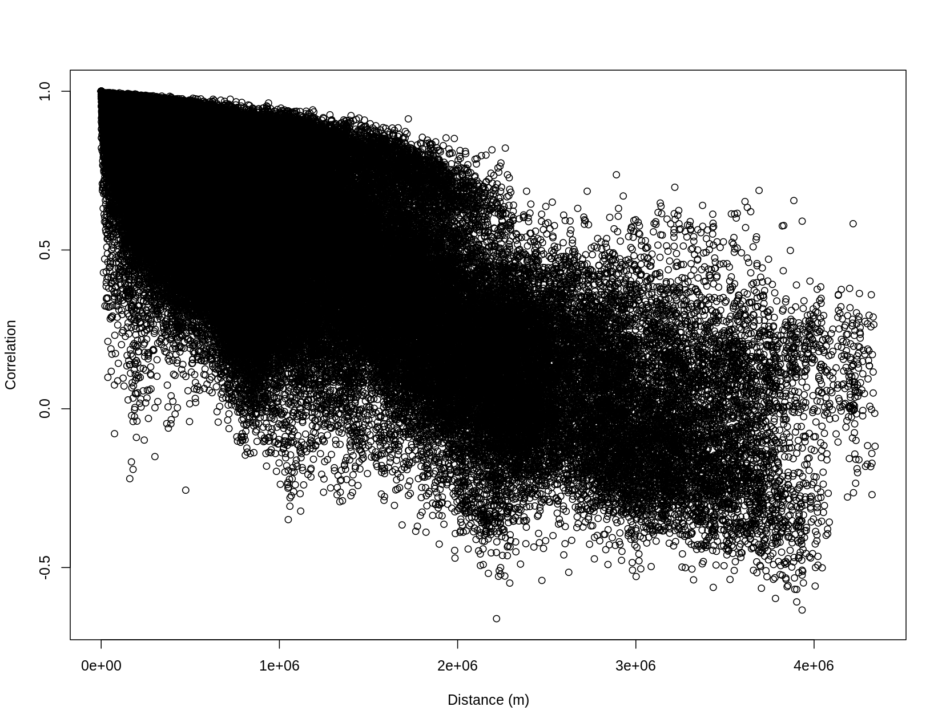
Structure
Correlation

Slide 11
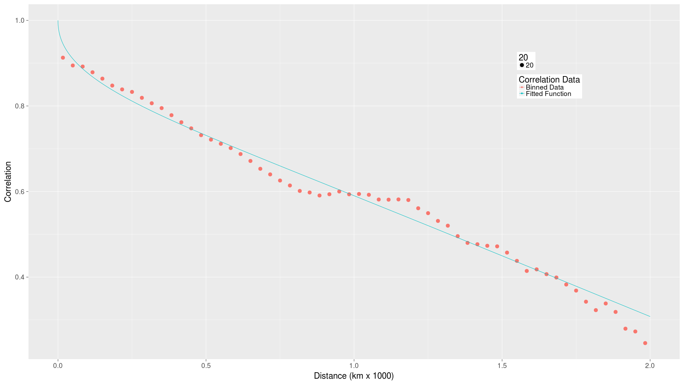
Structure
Correlation

Slide 12
Calculation of Optimal Station Separation
$ε_{opt}=1−\frac{2μ^{2}\left(\frac{ρ}{2}\right)}{1+η+μ\left(ρ\right)}$
$ε_{opt}=\frac{E_{allow}}{σ_{0}^{2}}$ $η=1−μ\left(0\right)$
With the correlation functions and an understanding of the variance in the field, we can specify an allowable mean squared error and compute the optimal station spacing to achieve that.
The radius of representativeness was calculated monthly and grouped by season and with acceptable errors of 0.5 °C and 1°C from the monthly average and 20-40% for precipitation.

Slide 13
Basic Distance Scales for Correlation
The correlation functions give us a month-by-month look at how the relationship, on average, declines with distance with the data that we have which gives is an initial sense of scale
Month | Precipitation (km) | Maximum Temp. (km) | Minimum Temp. (km)
January | 600 | 1910 | 1850
February | 570 | 1810 | 1710
March | 570 | 1820 | 1750
April | 250 | 1650 | 1580
May | 290 | 960 | 1610
June | 360 | 930 | 850
July | 420 | 910 | 1080
August | 520 | 890 | 1120
September | 620 | 1580 | 1880
October | 580 | 1650 | 1410
November | 580 | 1750 | 1770
December | 360 | 1930 | 1970

Slide 14
Optimal Length Scales for the Rockies
 | σ_{T} °C | 0.5 °C (km) | 1.0 °C (km) | σ_{T} ppt | 30 % (km)
Month | Daily Minimum Temperature |  |  | Precipitation
Jan. | 3.3 | 0 | 20 | 62 | 60
Feb. | 3.4 | 0 | 90 | 68 | 60
Mar. | 2.2 | 0 | 290 | 48 | 40
Apr. | 1.4 | 20 | 2360 | 37 | 40
May | 1.2 | 160 | 3360 | 43 | 60
Jun. | 1.0 | 90 | 1210 | 40 | 100
Jul. | 1.0 | 30 | 1450 | 55 | 60
Aug. | 1.2 | 10 | 1510 | 43 | 20
Sep. | 1.2 | 60 | 2940 | 53 | 50
Oct. | 1.4 | 30 | 2430 | 45 | 70
Nov. | 2.5 | 0 | 330 | 40 | 40
Dec. | 3.1 | 0 | 50 | 38 | 10

Slide 15
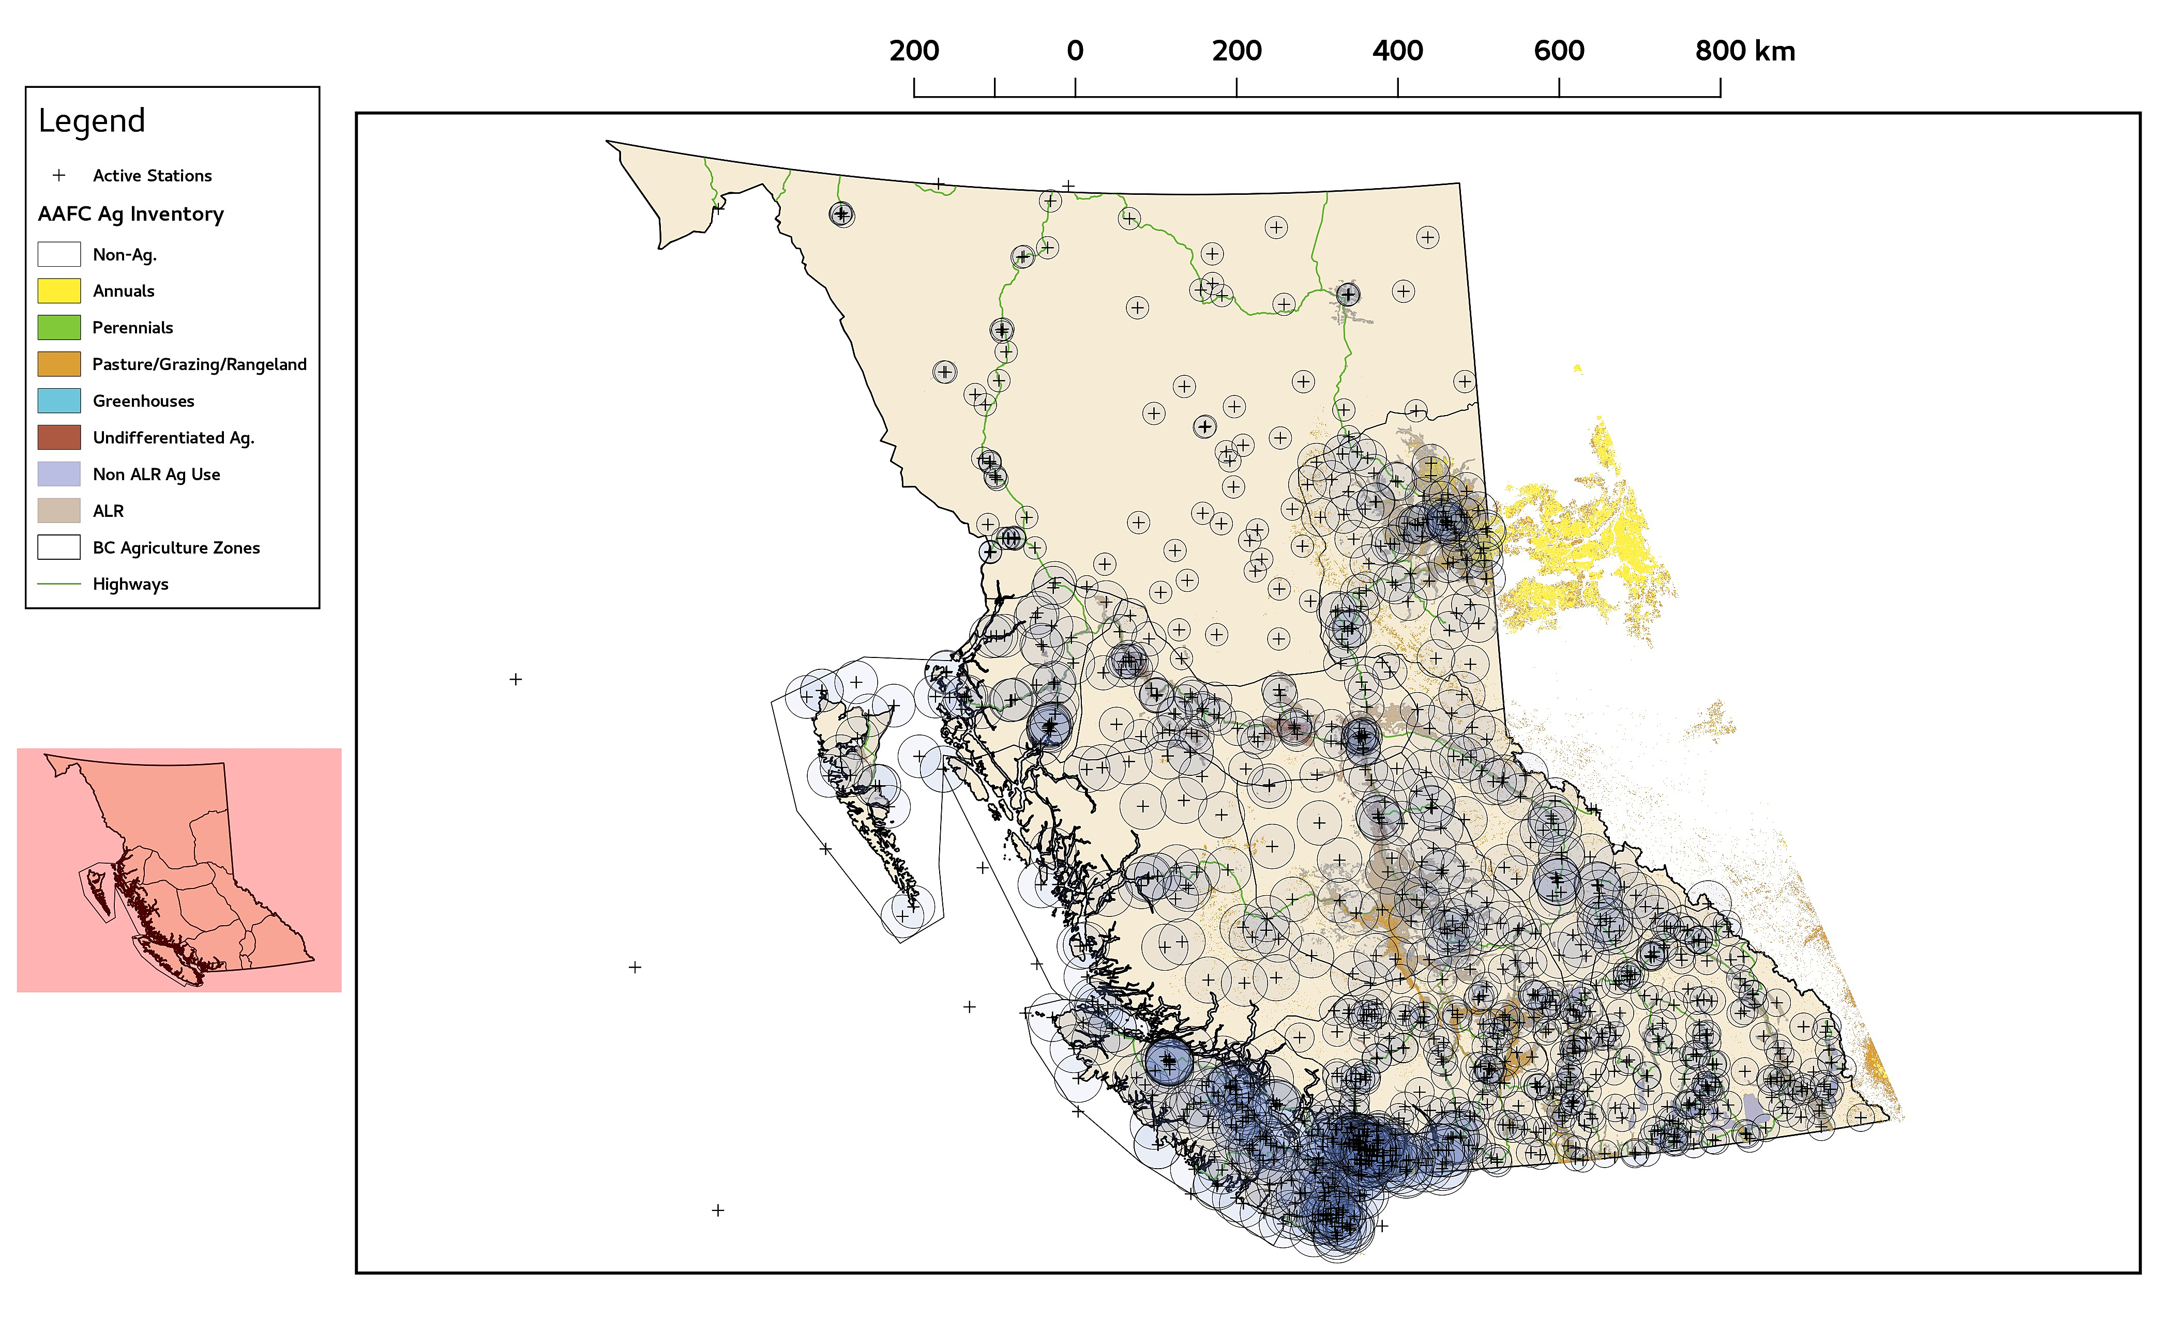
Optimal Station Separation Results
DJF PPT 30%

Slide 16
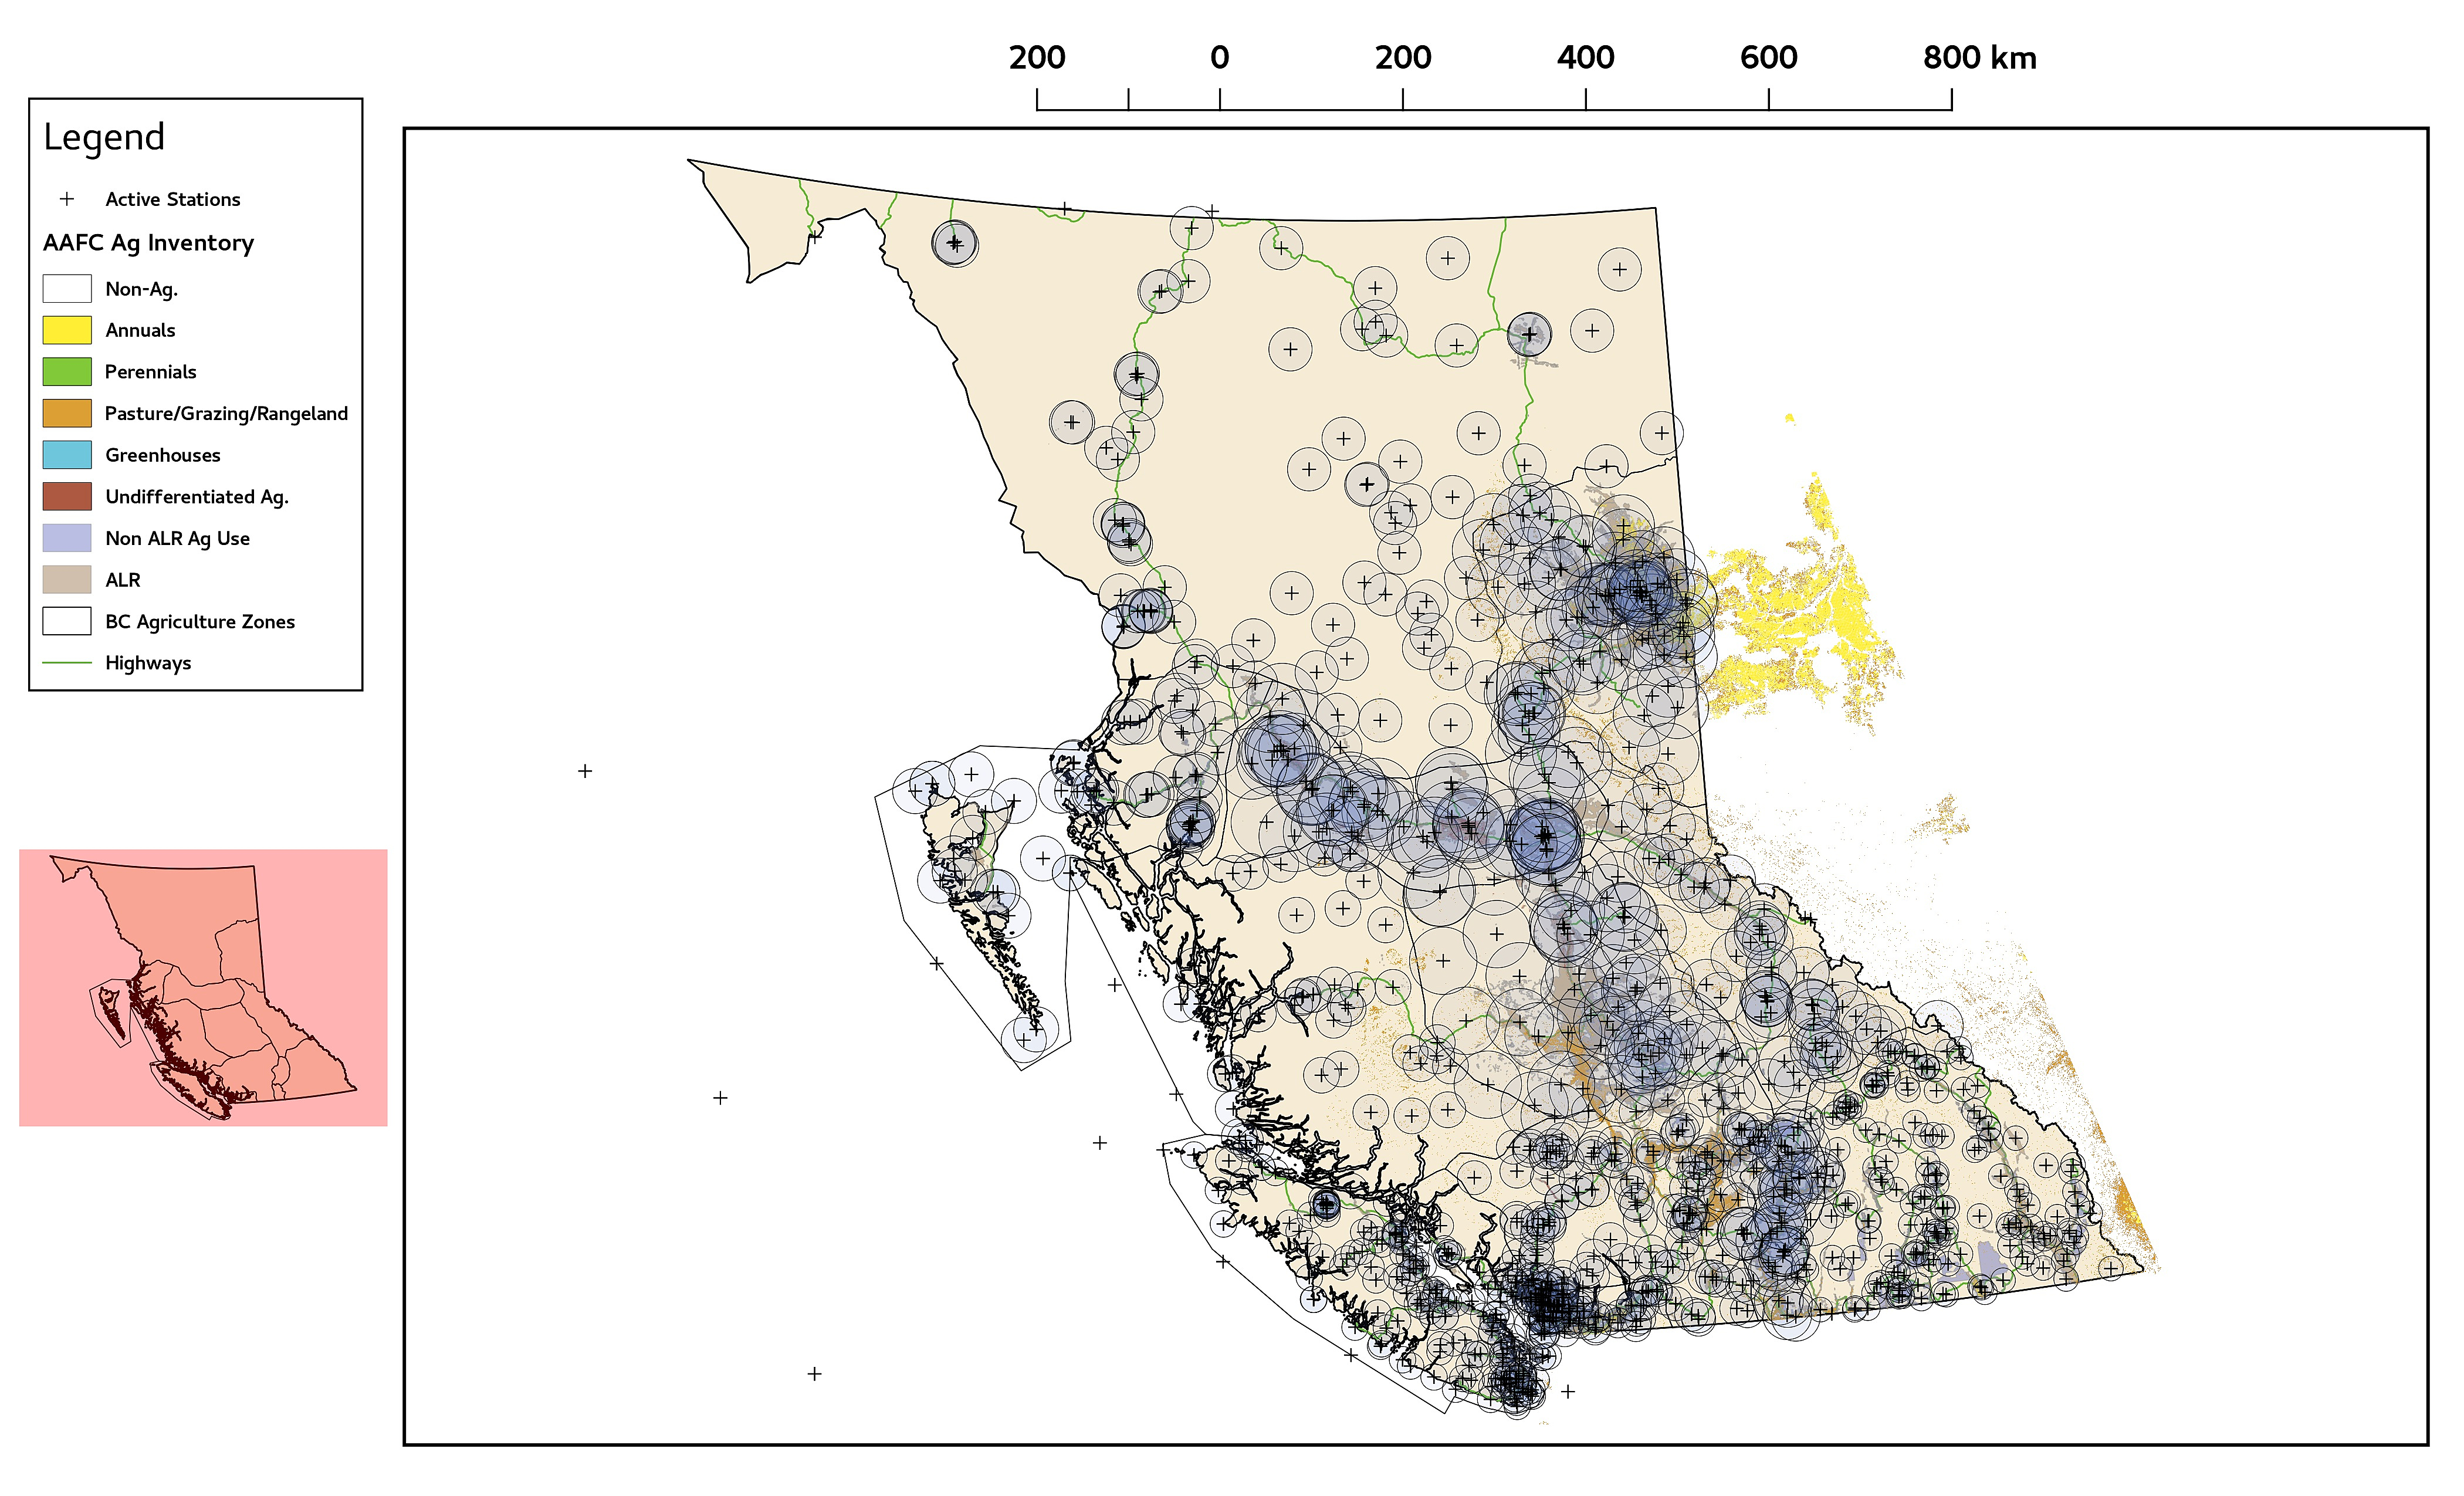
Optimal Station Separation Results
DJF Tmin 1.0 °C

Slide 17
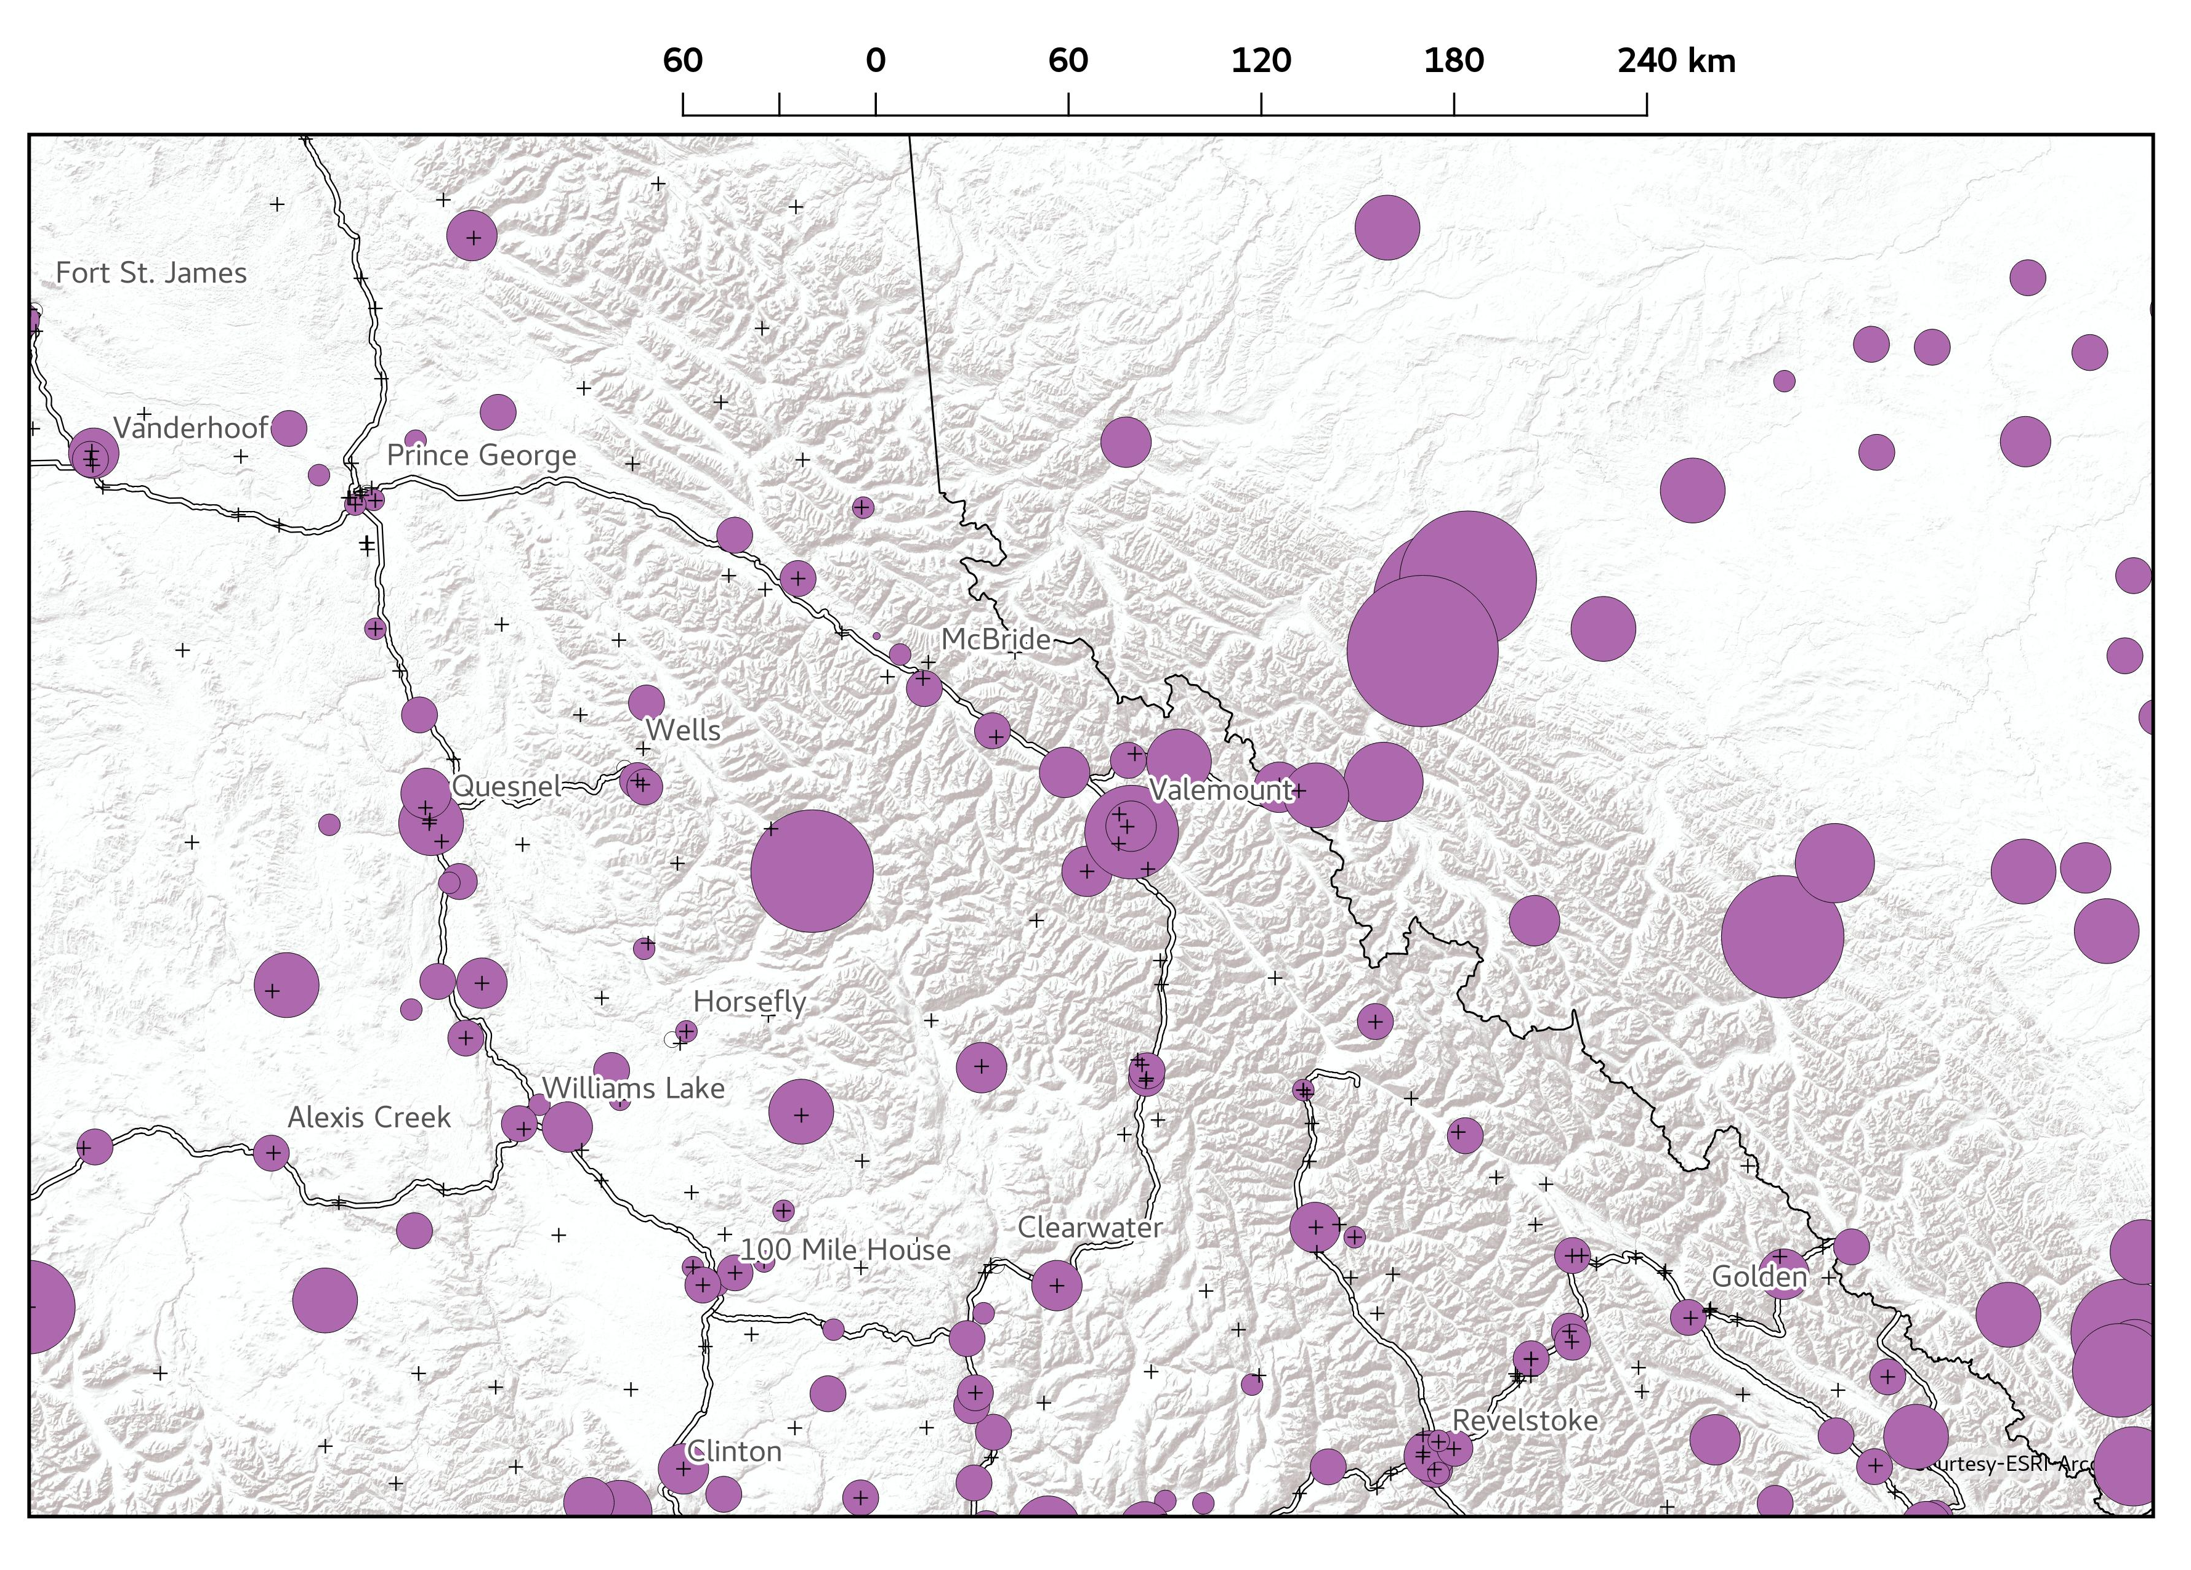
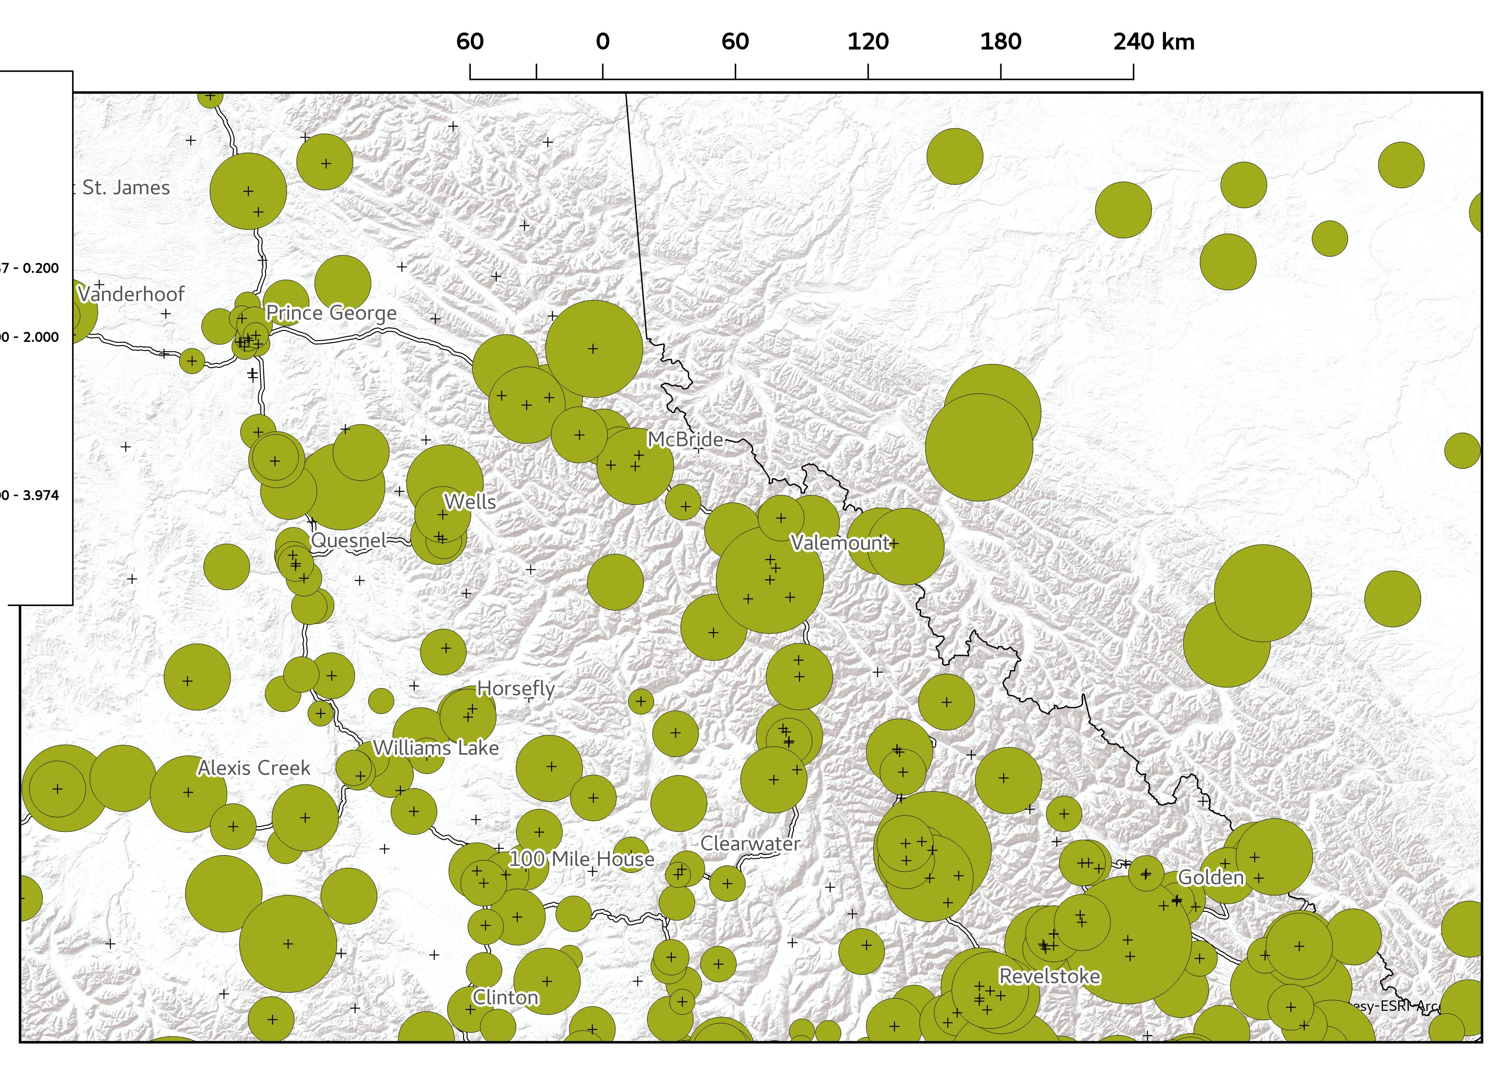
Insights from Structure Analysis
January Precipitation
January Minimum Temp

Slide 18
Conclusions
This analysis can tell us about the sufficiency of the observing network on a month-by-month basis
Temperature is correlated at large spatial scales in winter and shorter spatial scales in summer
Variance in temperature is high during winter leading to need for higher observational density to achieve a set accuracy target than in summer.
The analysis is probably affected by large observational errors esp. winter precipitation
The structure analysis tells us about how data at any historical stations with sufficient record length varies relative to its neighbours
Over smooth topography, there is much less variation in temperature due to reduced microclimate effects.
Precipitation shows large variability in both prairie and mountainous environments
We can use the analysis to explicitly calculate optimal interstation distances and how they vary in time.

Slide 20
Geographic Observational Network Assessment
Assess the network coverage based on
the location of stations
definition of agricultural region boundaries
list of what variables are at what stations
Do this using simple statistics within regional groups
Interstation distances
Areal station density
And also using Voronoi polygons that define representative areas per station

Slide 22
Geographic Observational Network Assessment
Interstation distances
Region | Median to 1st | Median to 2nd | Min. to 1st | Min. to 2nd | Max. to 1st | Max. to 2nd
North | 18 | 34 | 0 | 1 | 152 | 153
Peace | 8 | 17 | 0 | 0 | 68 | 71
North Coast | 7 | 20 | 0 | 2 | 44 | 99
Prince George | 7 | 14 | 0 | 0 | 45 | 49
Rockies | 13 | 20 | 0 | 2 | 46 | 52
Central Coast | 21 | 34 | 0 | 9 | 76 | 90
Cariboo | 18 | 23 | 1 | 4 | 53 | 60
Kootenay | 7 | 14 | 0 | 1 | 49 | 50
Vancouver Island | 7 | 10 | 0 | 0 | 41 | 78
South Okanagan | 8 | 12 | 0 | 2 | 21 | 21
Lower Mainland | 2 | 5 | 0 | 0 | 12 | 21
South West Interior | 7 | 12 | 0 | 1 | 47 | 54
North Okanagan | 5 | 11 | 0 | 0 | 17 | 24

Slide 23
Geographic Observational Network Assessment
Areal Averages unguided and with Voronoi Polygons (Peace Region Sample)
Variable | N | A (km²) | 1/A (km⁻²) | Med. A_{vor} (km²) | Min. A_{vor} (km²) | Max. A_{vor} (km²)
Temperature | 91 | 736 | 1.36E-03 | 614 | 2 | 2991
Humidity | 67 | 1000 | 1.00E-03 | 579 | 2 | 8771
Precipitation | 78 | 859 | 1.16E-03 | 693 | 2 | 3142
Rainfall | 77 | 870 | 1.15E-03 | 686 | 2 | 3997
AS Precipitation | 23 | 2913 | 3.43E-04 | 3199 | 152 | 12288
Snow | 20 | 3349 | 2.99E-04 | 3189 | 152 | 16991
Wind | 69 | 971 | 1.03E-03 | 547 | 2 | 8771
Any Radiation | 17 | 3941 | 2.54E-04 | 1129 | 2 | 44654
Net Radiation | 7 | 9570 | 1.04E-04 | 1235 | 48 | 91177
Photo. Radiation | 0 | NA | NA | NA | NA | NA
Short Wave | 13 | 5153 | 1.94E-04 | 1429 | 99 | 50995
Long Wave | 4 | 16747 | 5.97E-05 | 40 | 0 | 84
Air Pressure | 27 | 2481 | 4.03E-04 | 841 | 2 | 19213
Ground Flux | 11 | 6090 | 1.64E-04 | 48 | 2 | 259
Hydrol. Vars. | 9 | 7443 | 1.34E-04 | 10236 | 3914 | 32027

